Slide 1
ECE 884 Deep Learning
Lecture 20: Transformer Model
04/01/2021

Slide 2
Review of last lecture
RNN Applications
Text generation (many to one)
Image Captioning (one to many)
Neural Machine Translation (many to many - Seq2Seq)
Attention with RNN
Self-attention with RNN

Slide 3
Today’s lecture
Attention without RNN
Self-Attention without RNN
Transformer Model
Notes:
To add:
Weight initialization
Batch normalization

Slide 4
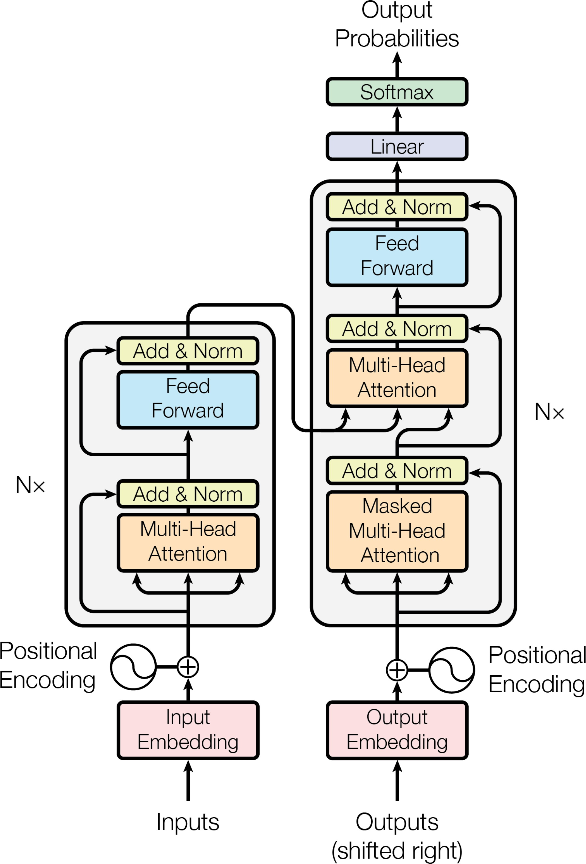
Transformer Model
Transformer is a Seq2Seq model.
Transformer is not RNN.
Purely based on attention and dense layers.
Higher accuracy than RNNs on large datasets.

Slide 5
Revisiting Attention for RNN

Slide 6
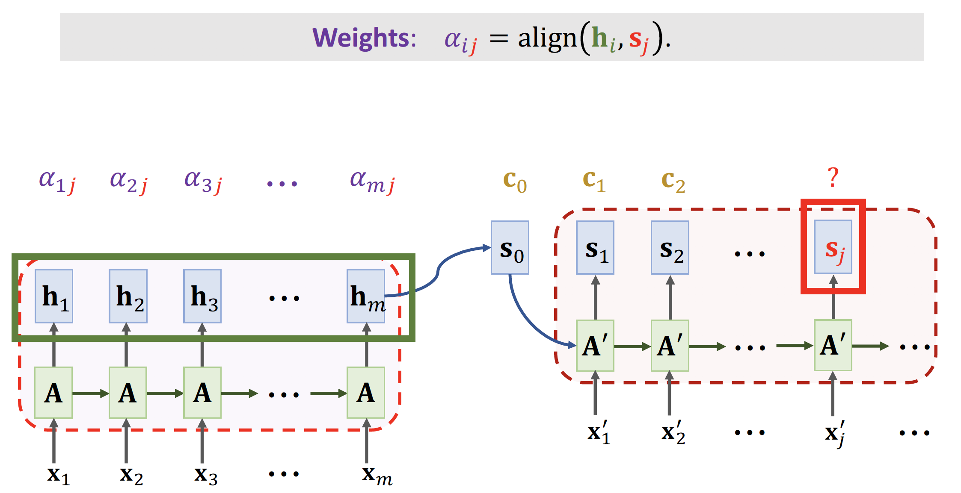
Attention for Seq2Seq Model

Slide 7
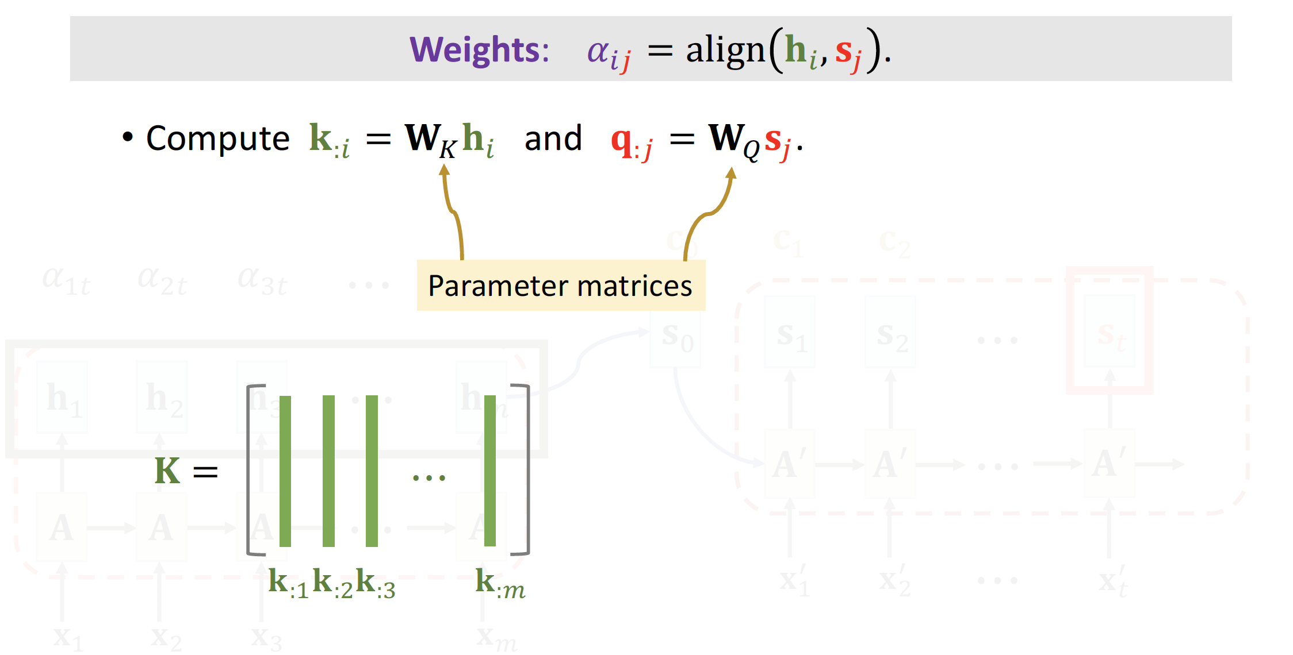
Attention for Seq2Seq Model

Slide 8
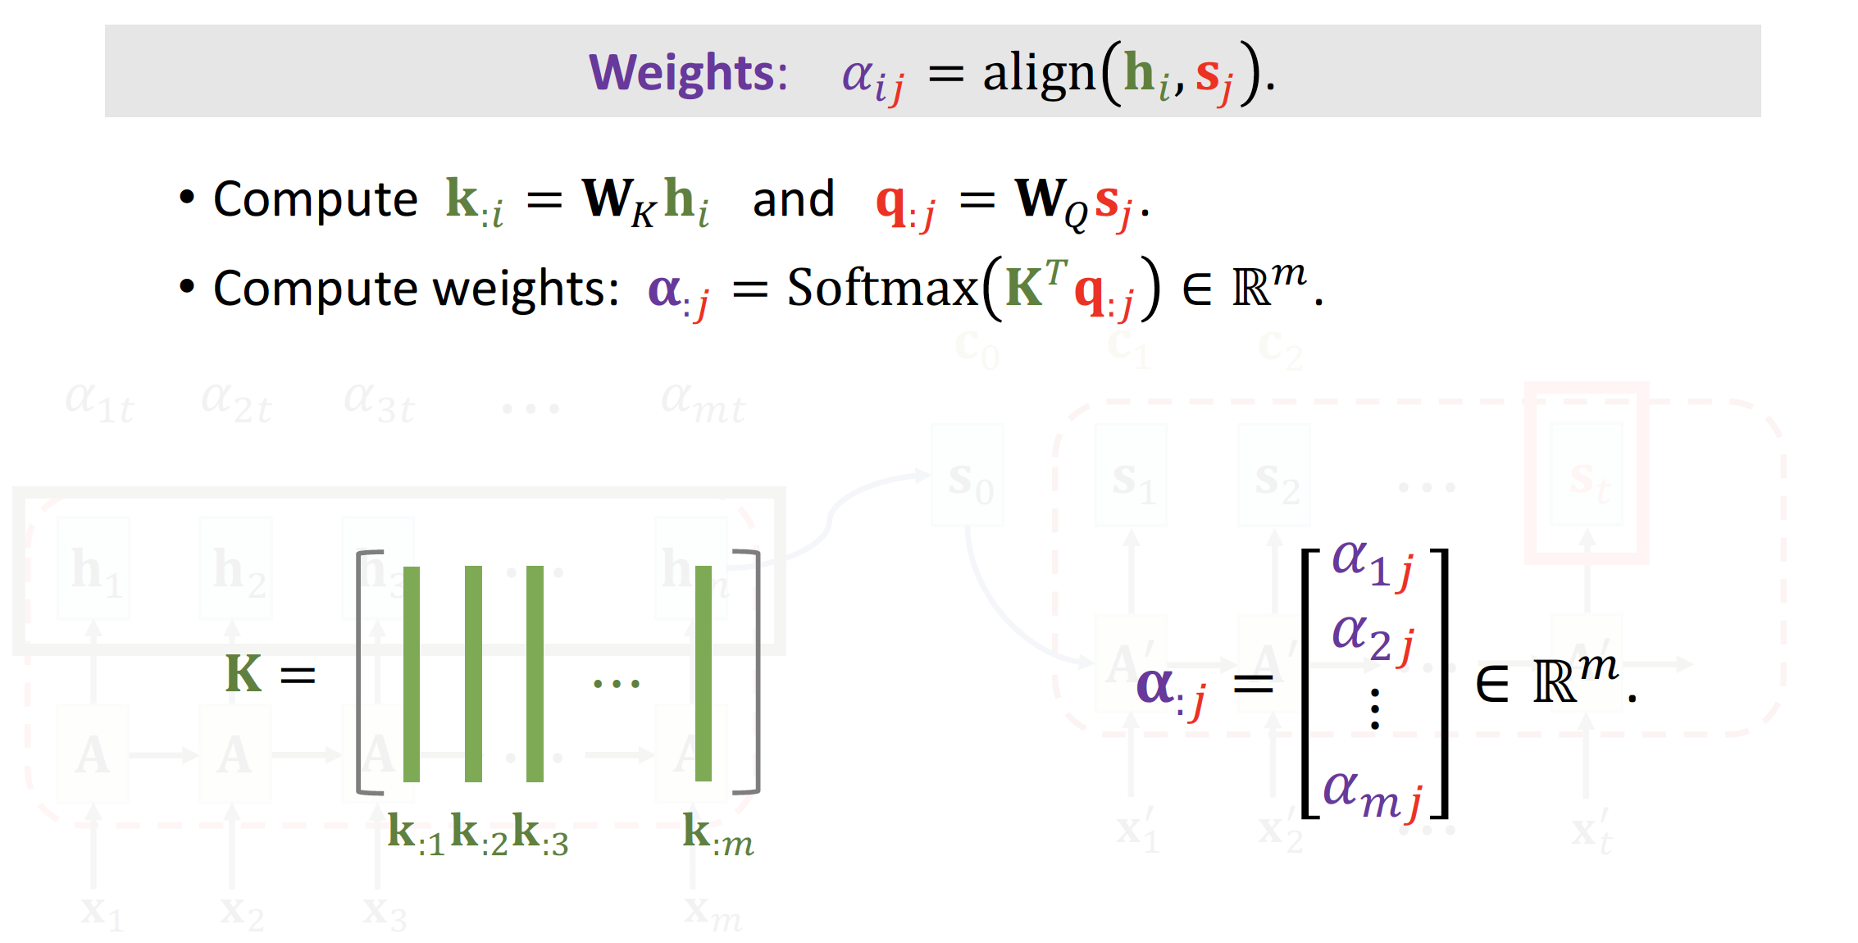
Attention for Seq2Seq Model

Slide 9
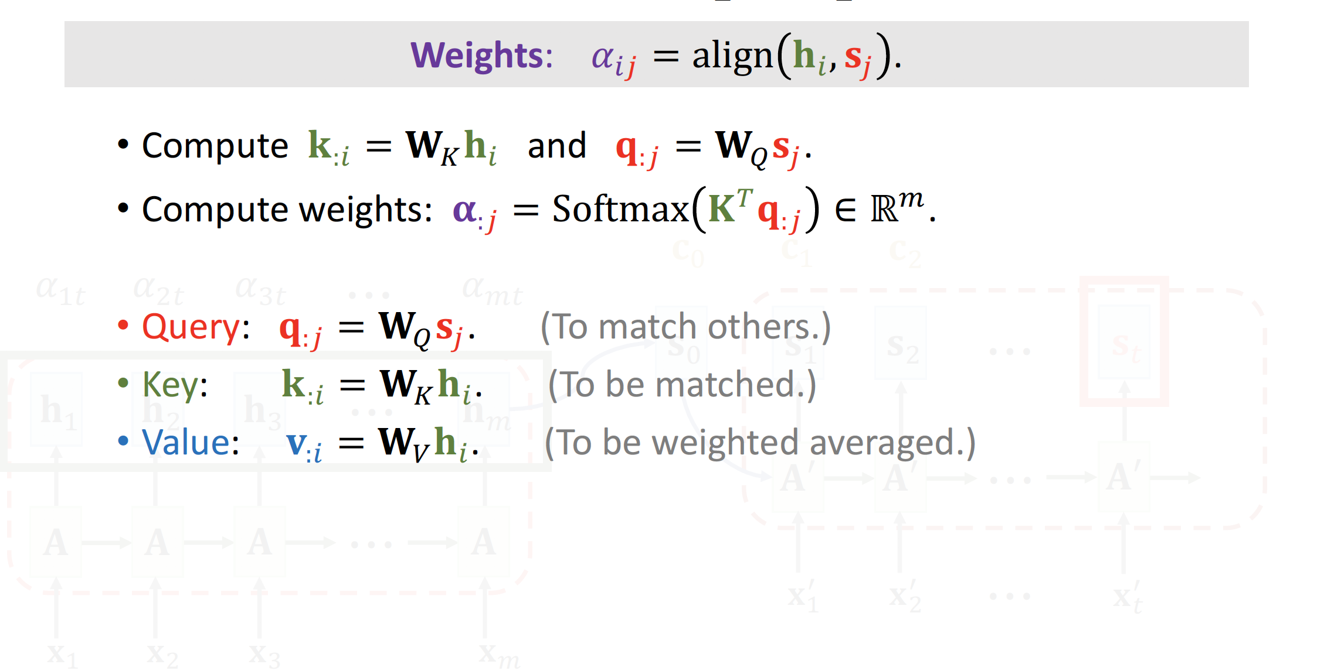
Attention for Seq2Seq Model

Slide 10
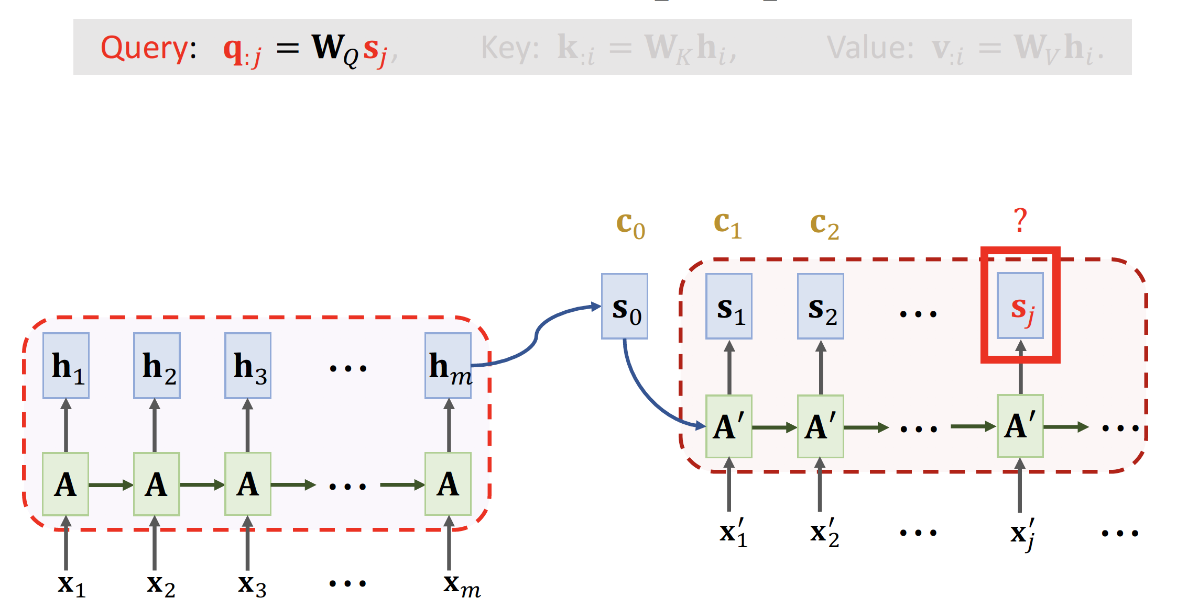
Attention for Seq2Seq Model

Slide 11
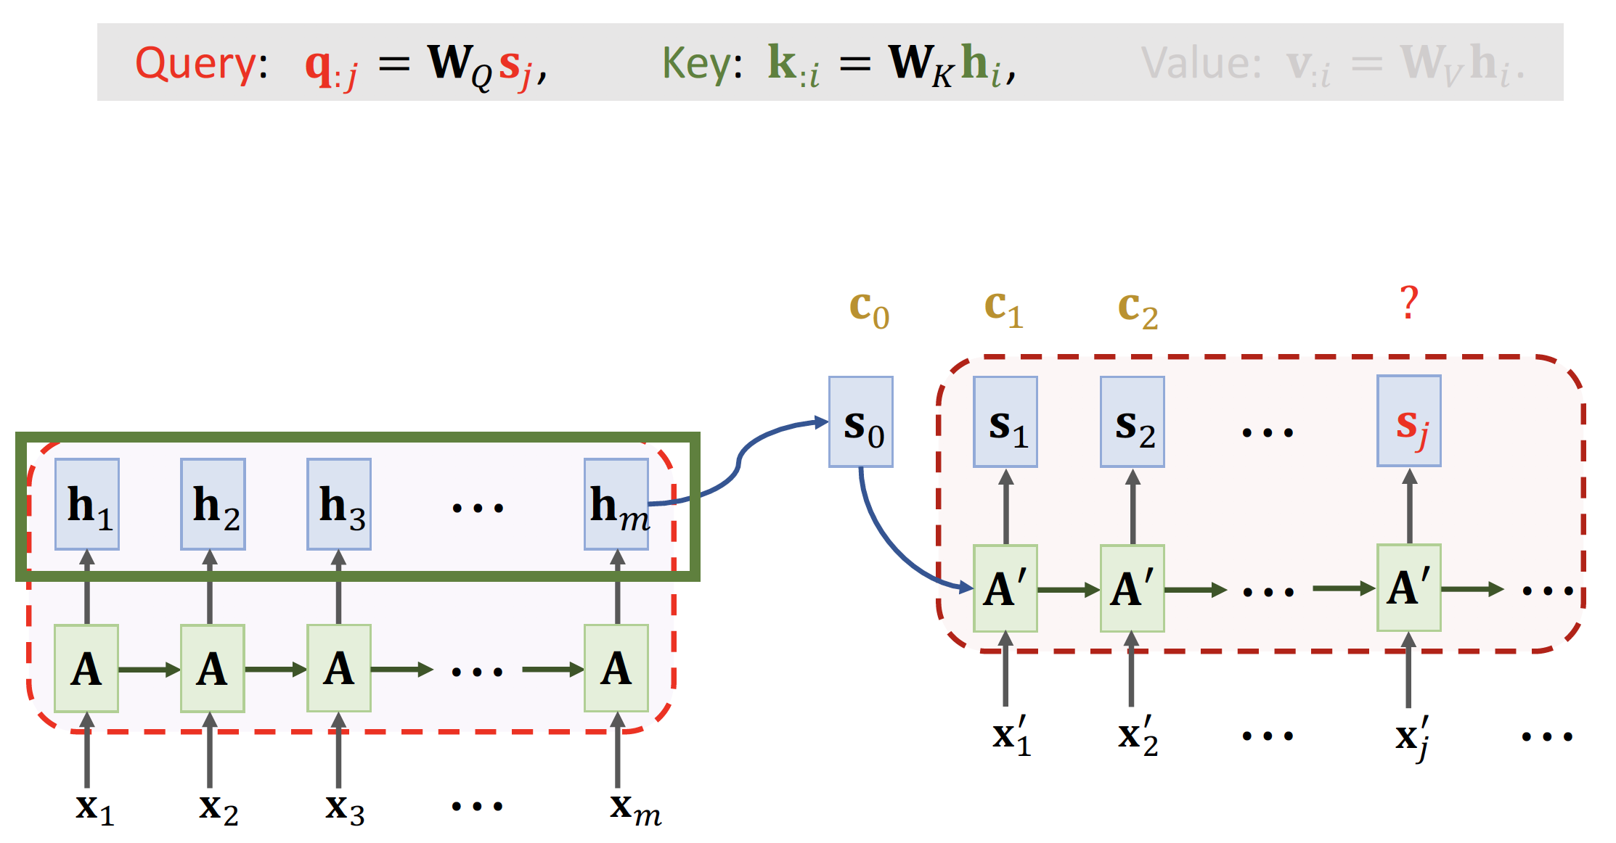
Attention for Seq2Seq Model

Slide 12
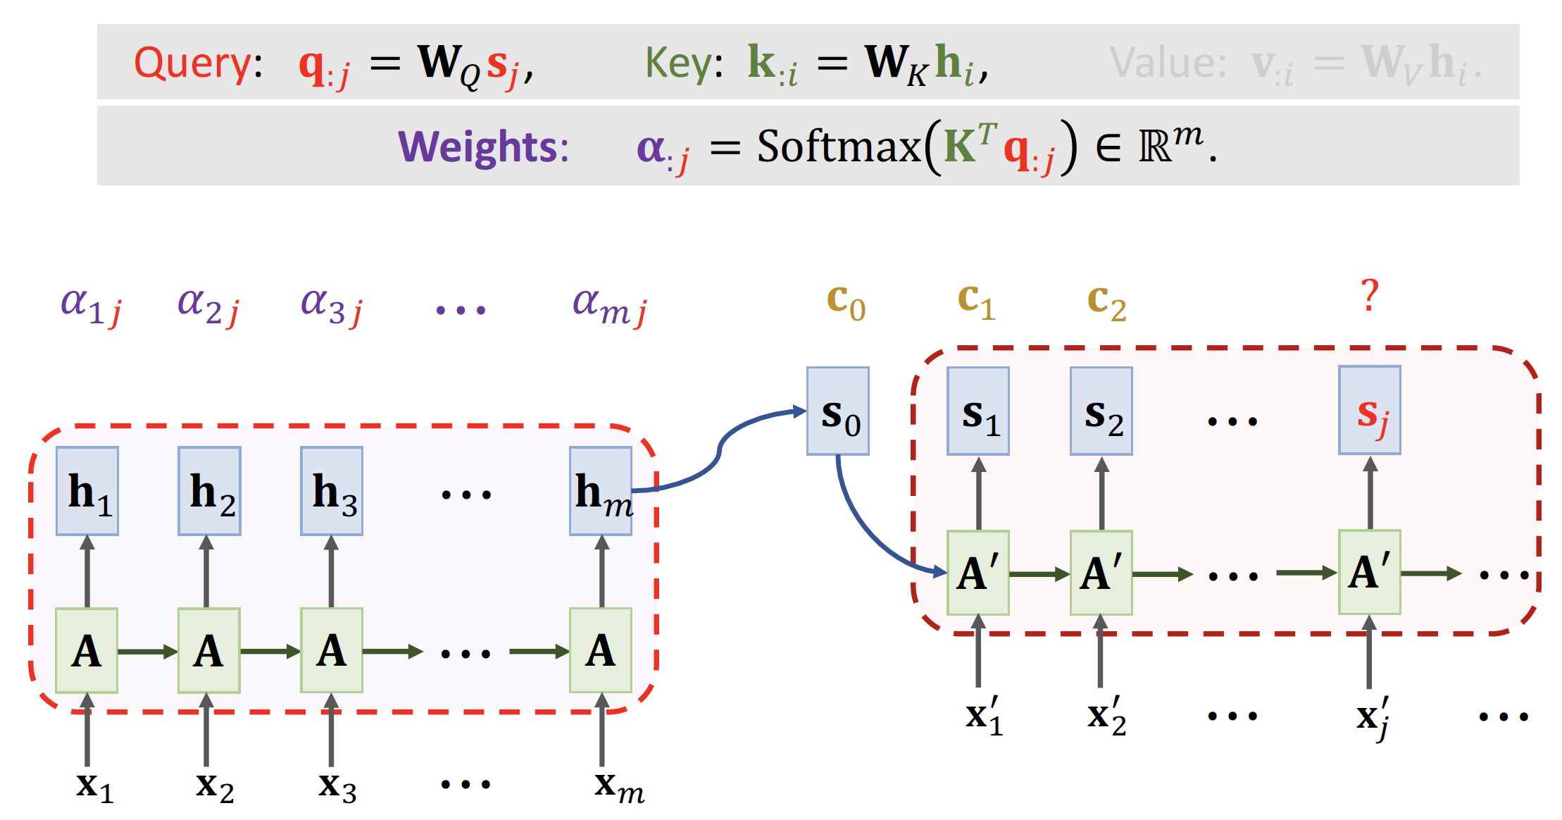
Attention for Seq2Seq Model

Slide 13
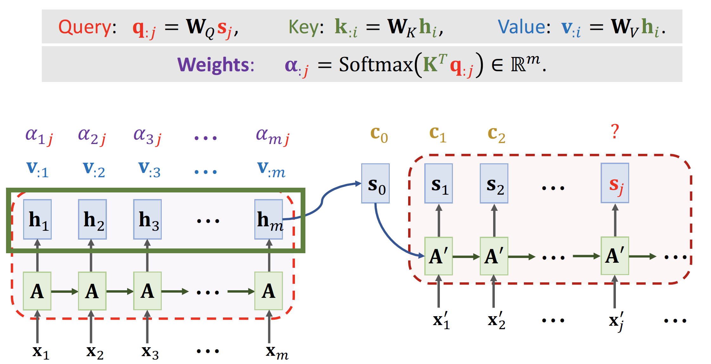
Attention for Seq2Seq Model

Slide 14
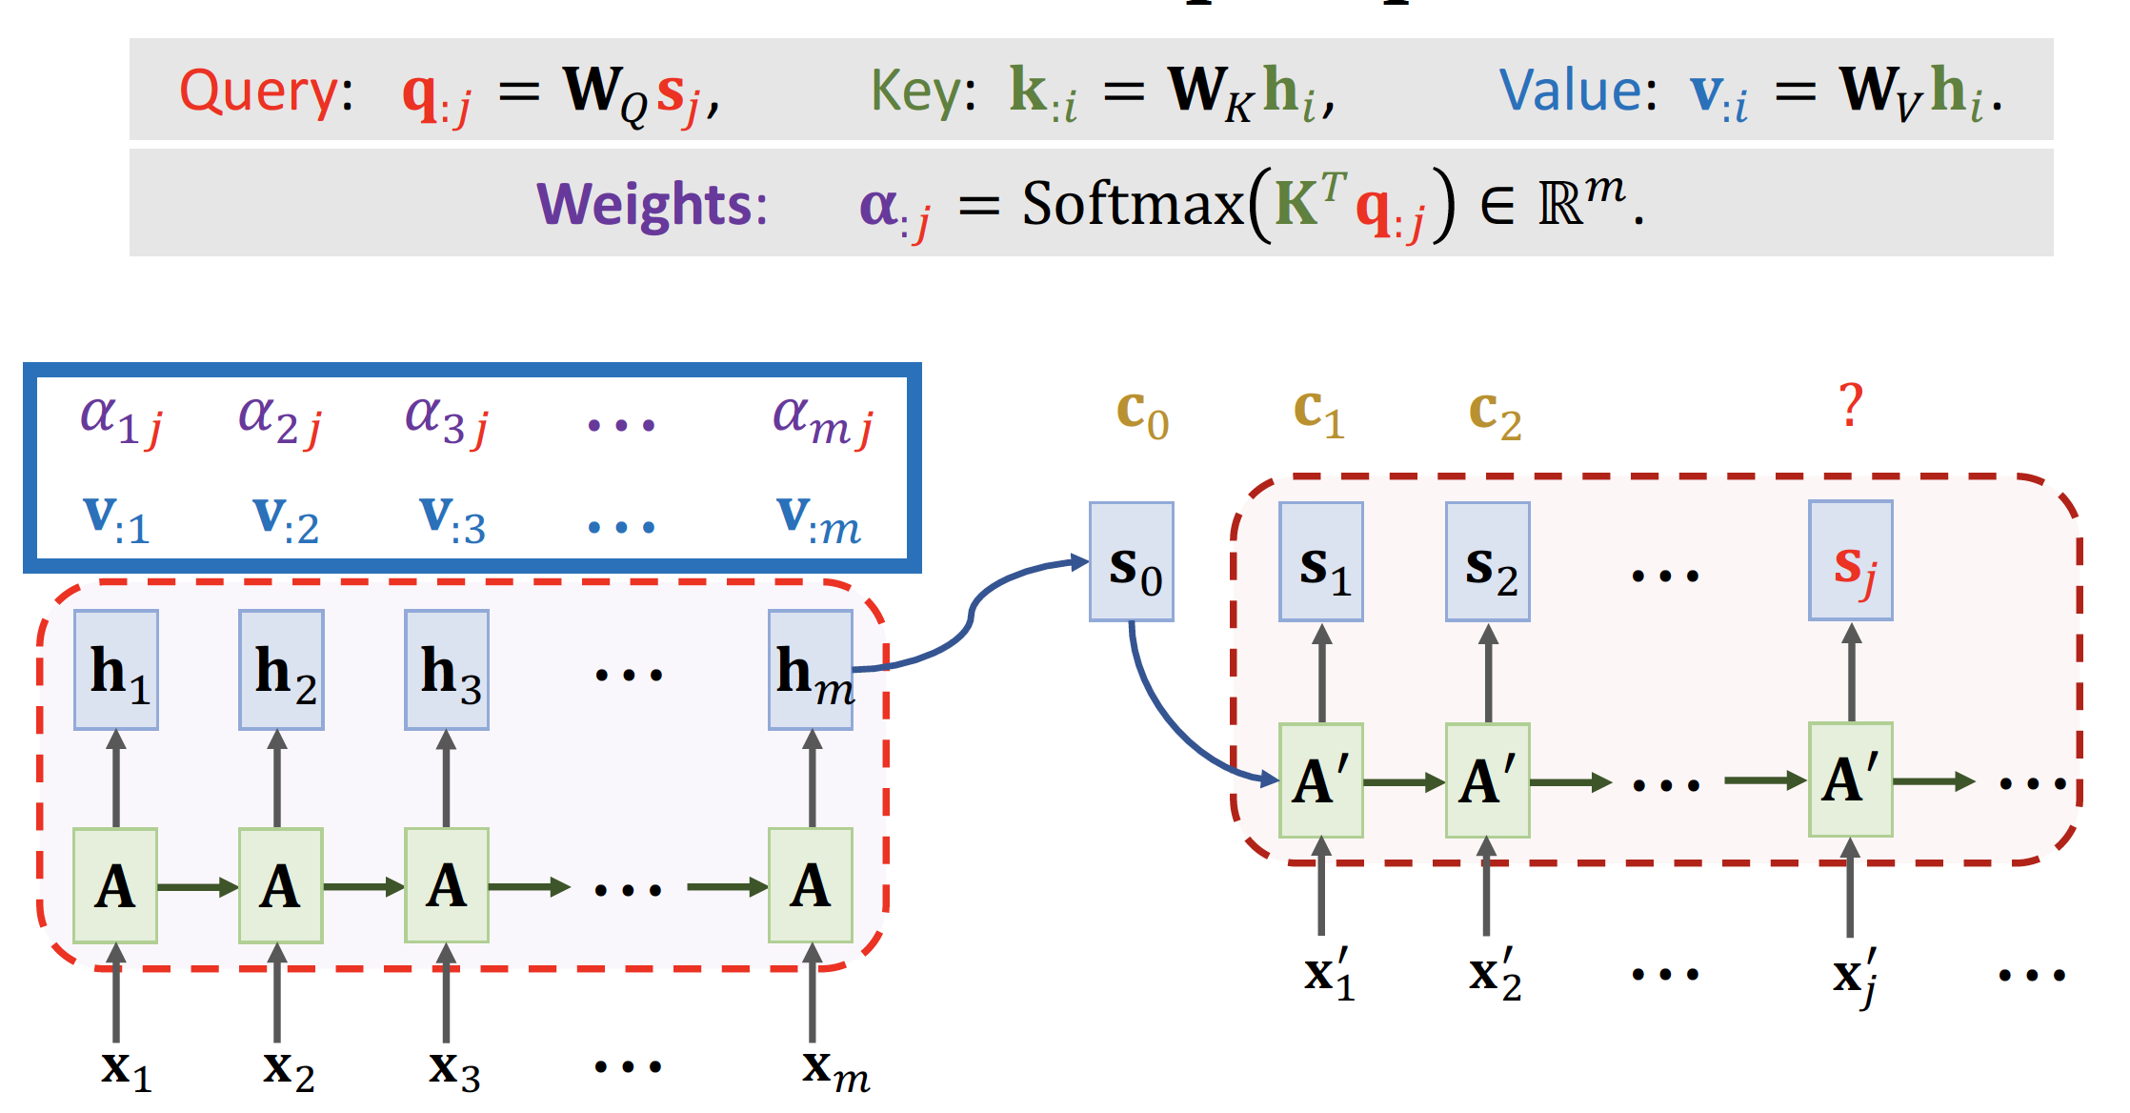
Attention for Seq2Seq Model

Slide 15
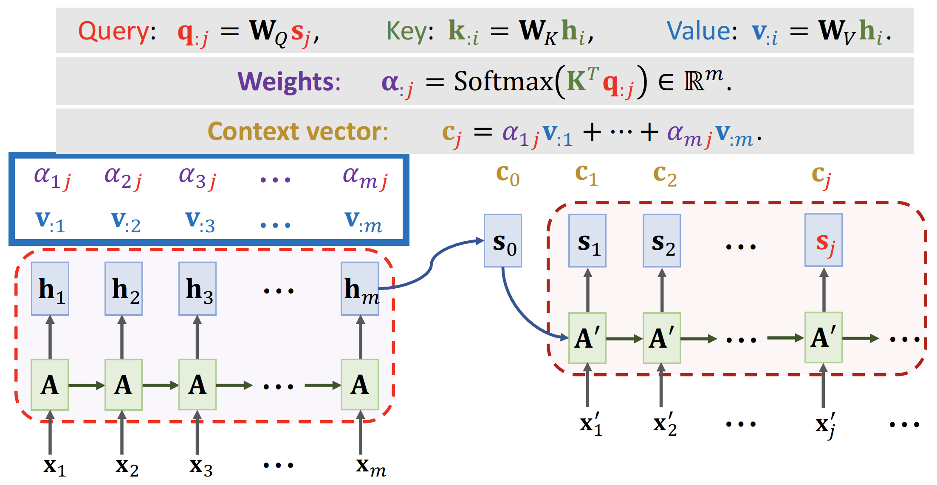
Attention for Seq2Seq Model

Slide 16
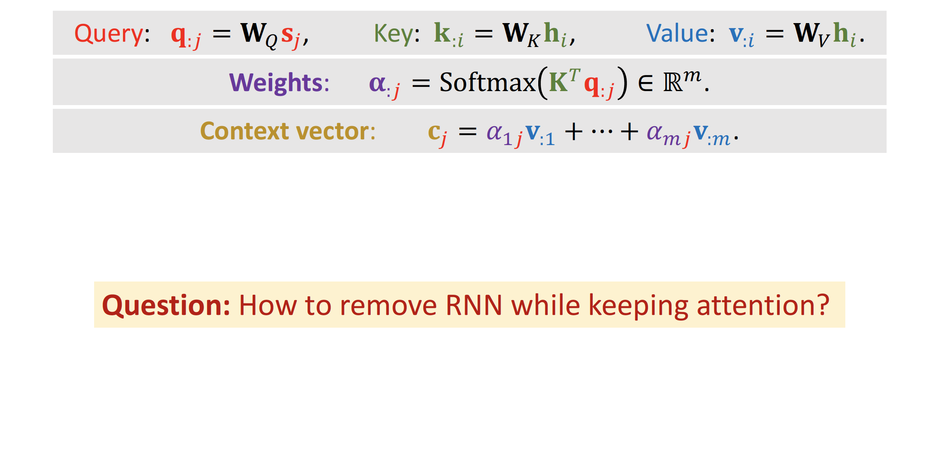
Attention for Seq2Seq Model

Slide 17
Attention without RNN

Slide 18
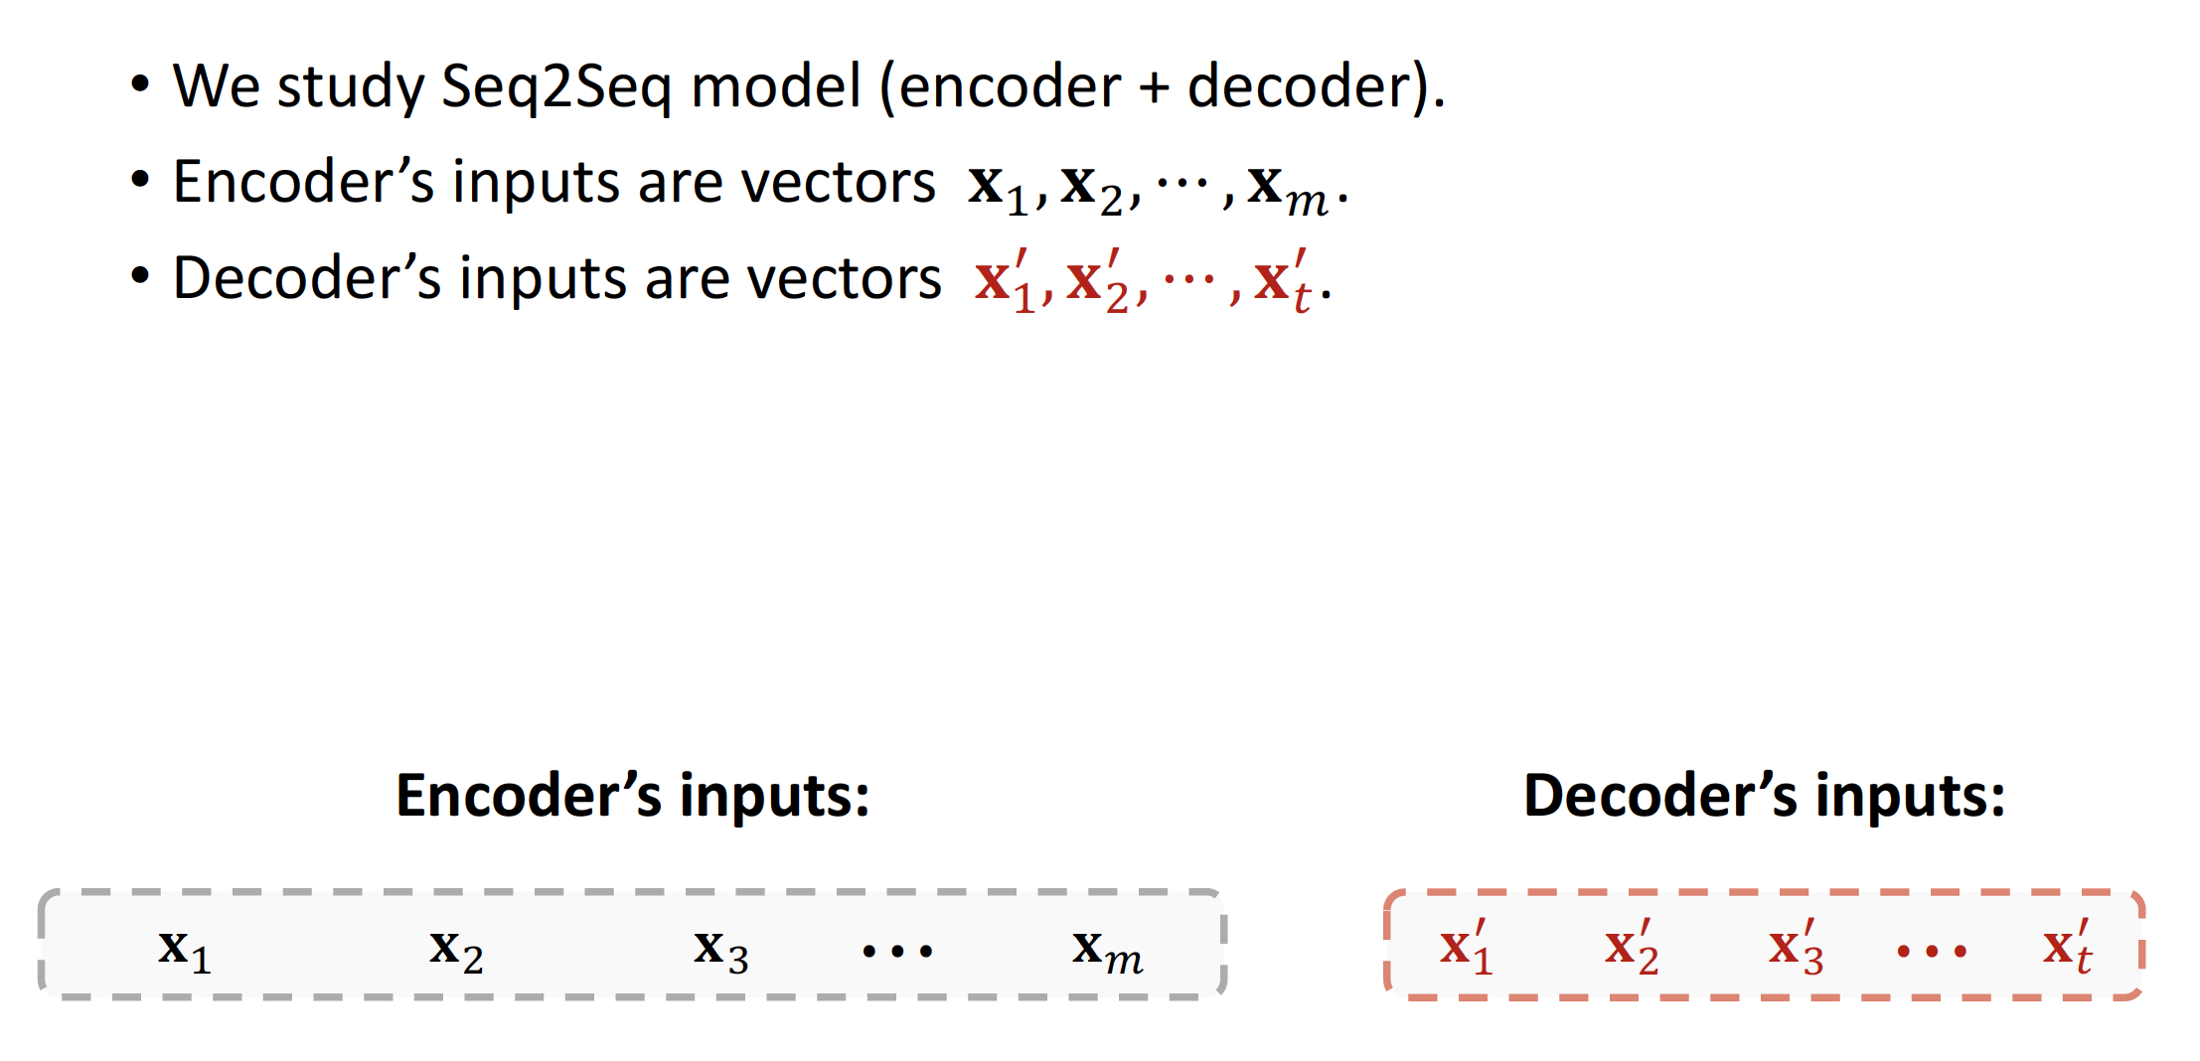
Attention Layer

Slide 19
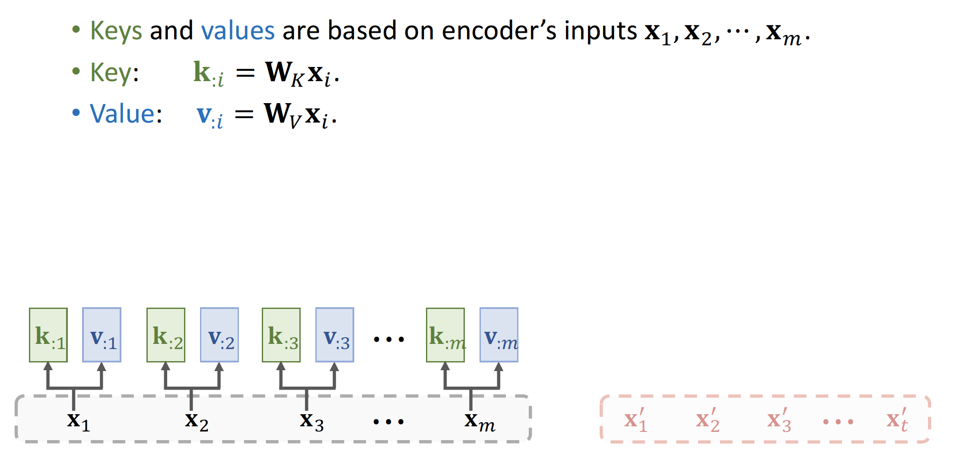
Attention Layer

Slide 20
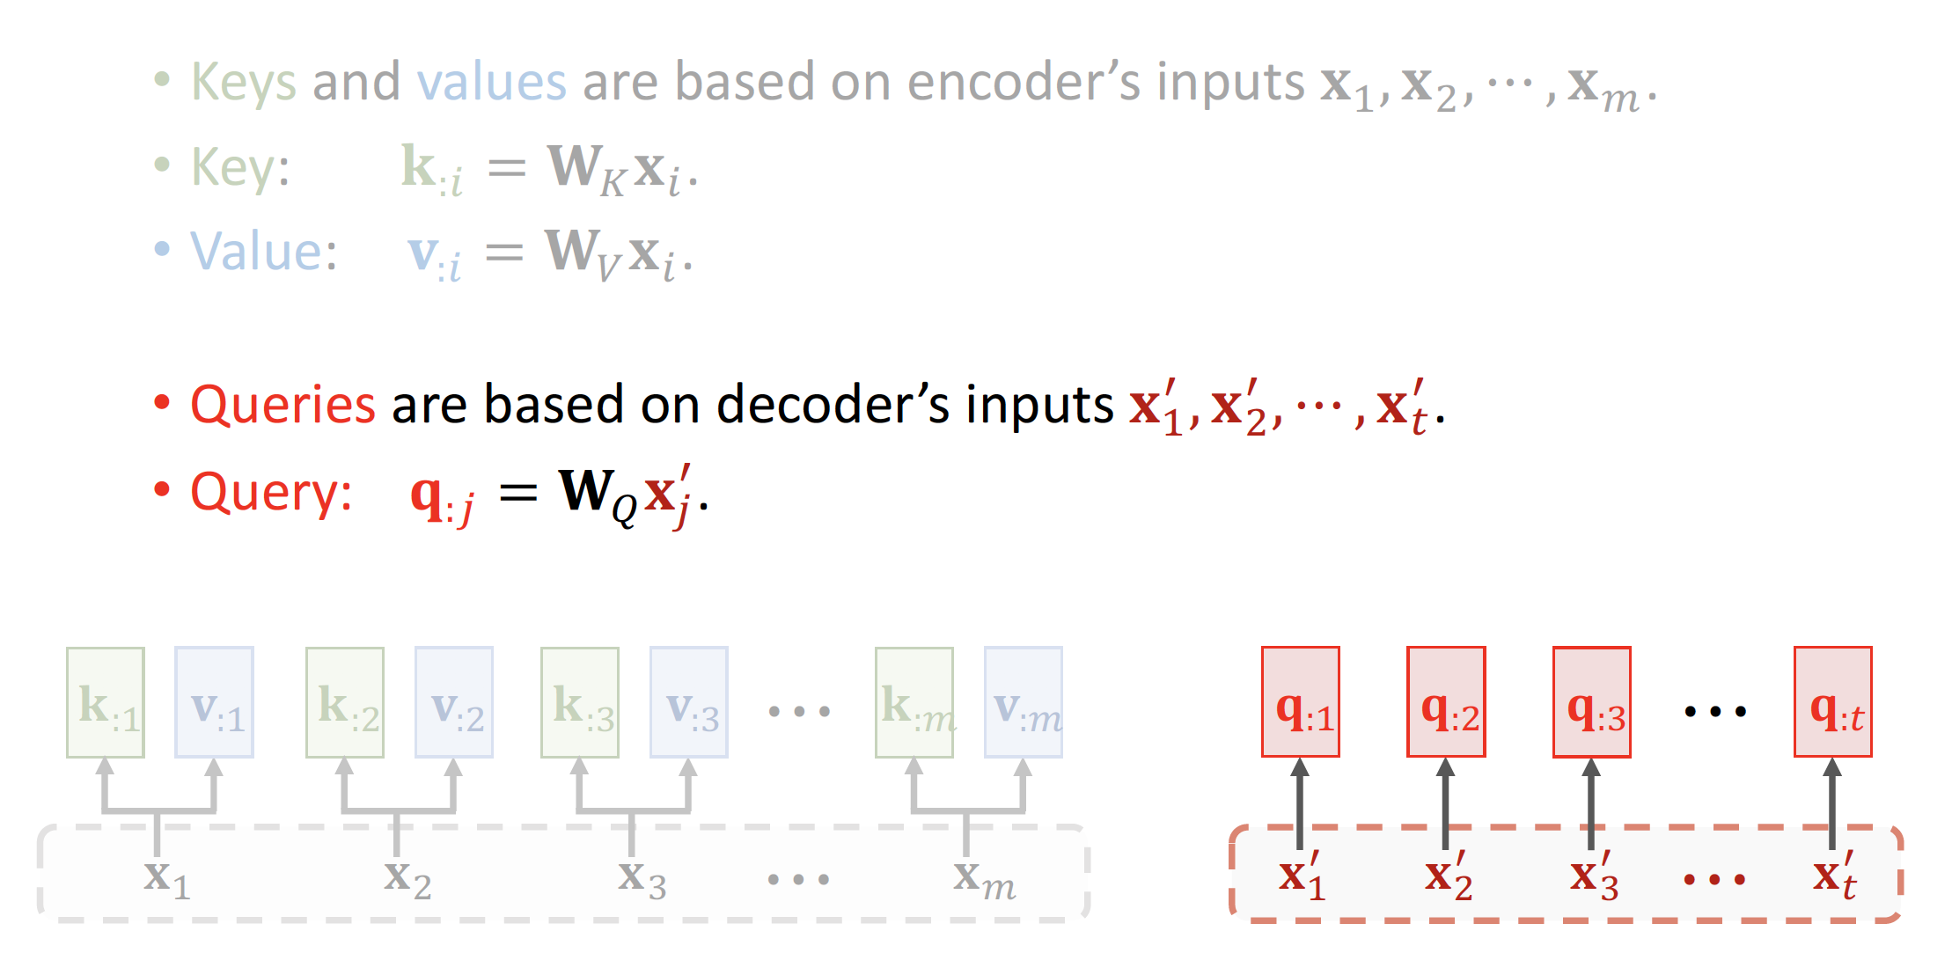
Attention Layer

Slide 21
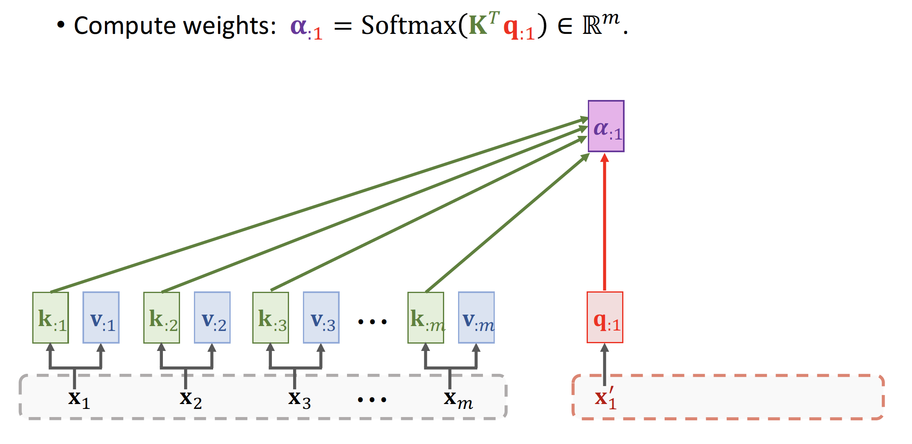
Attention Layer

Slide 22
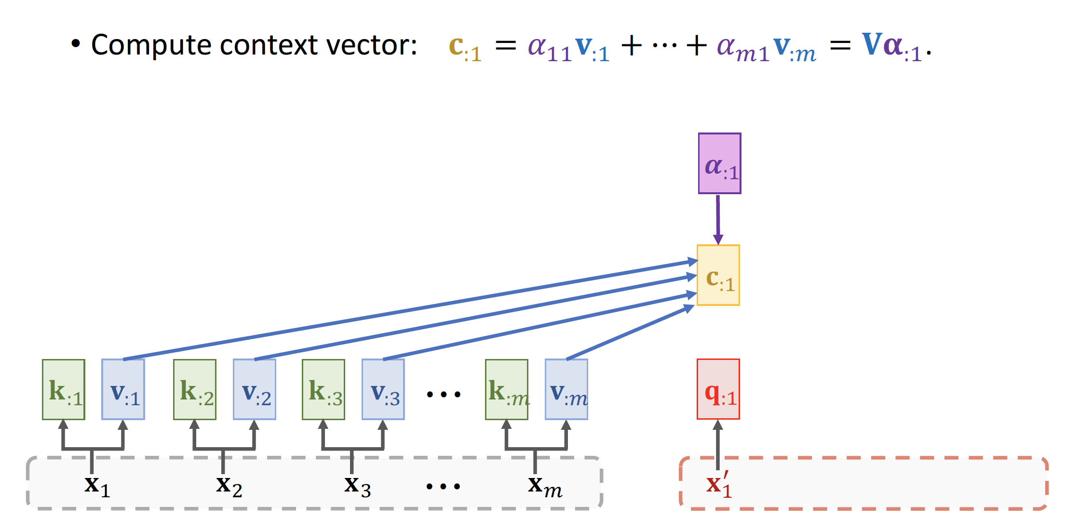
Attention Layer

Slide 23
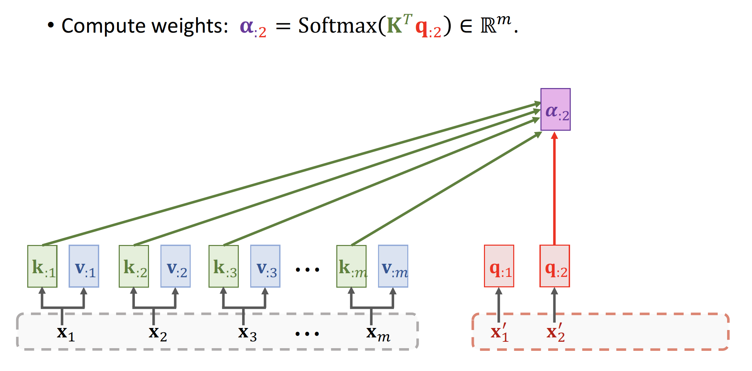
Attention Layer

Slide 24
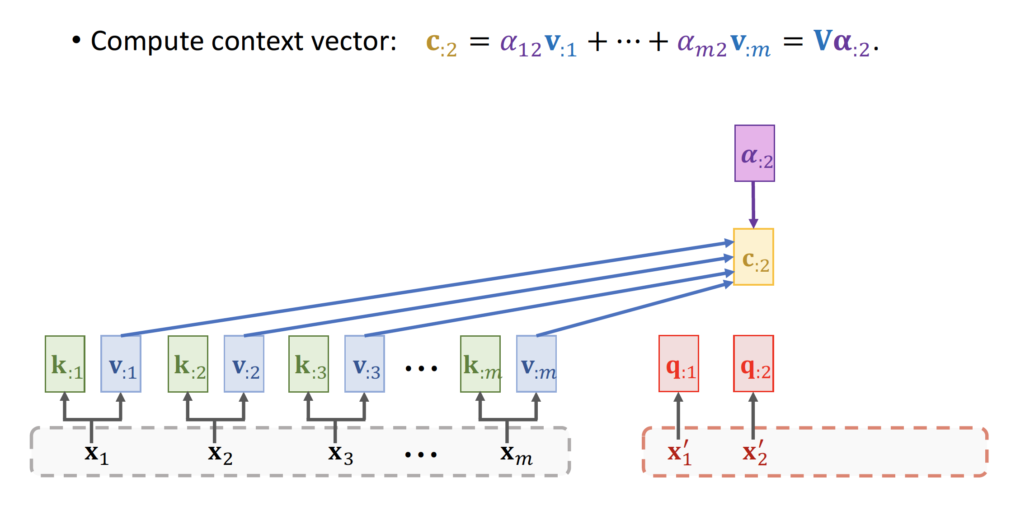
Attention Layer

Slide 25
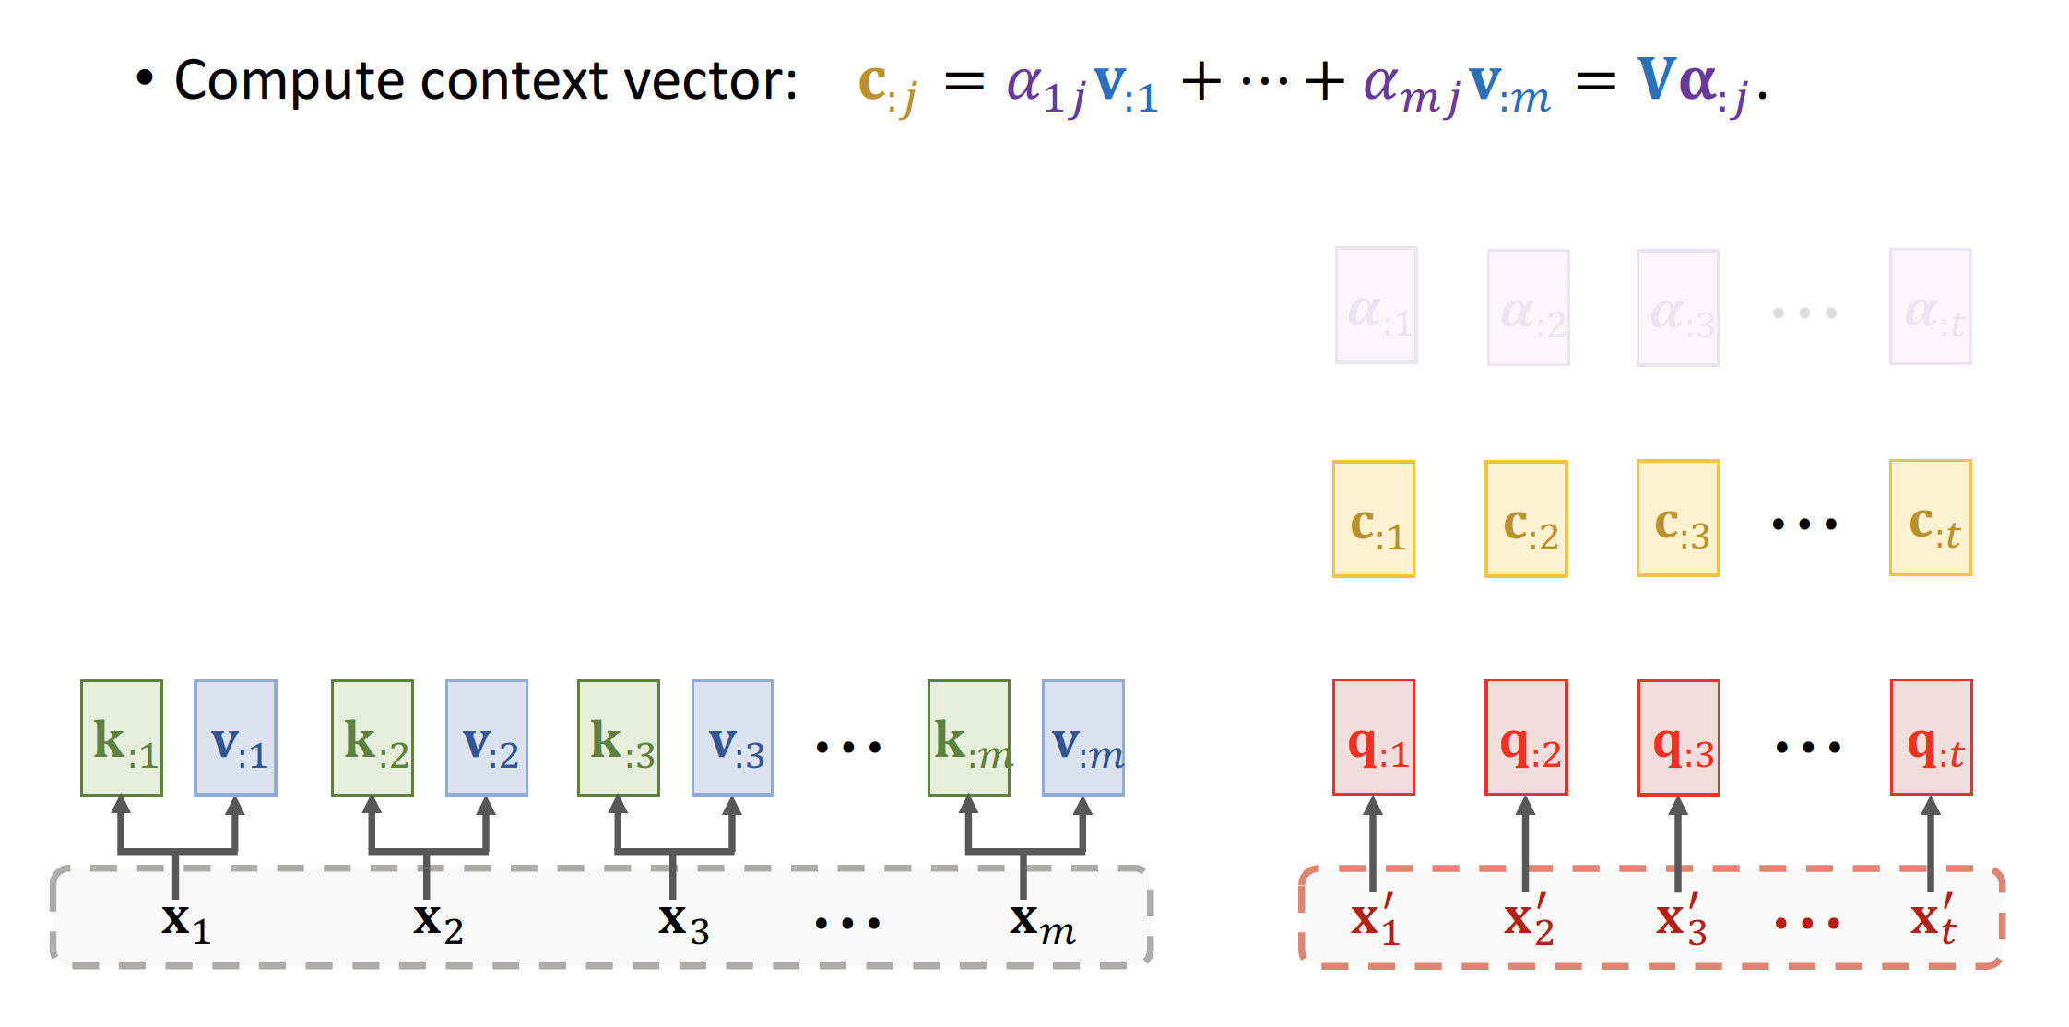
Attention Layer

Slide 26
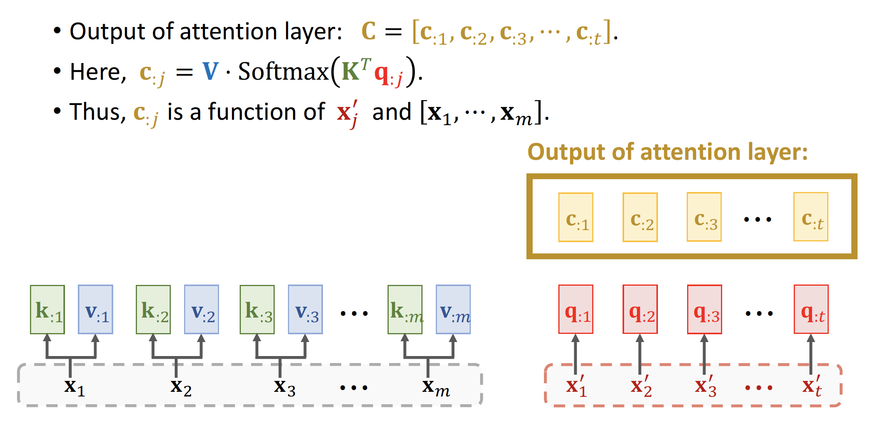
Attention Layer

Slide 27
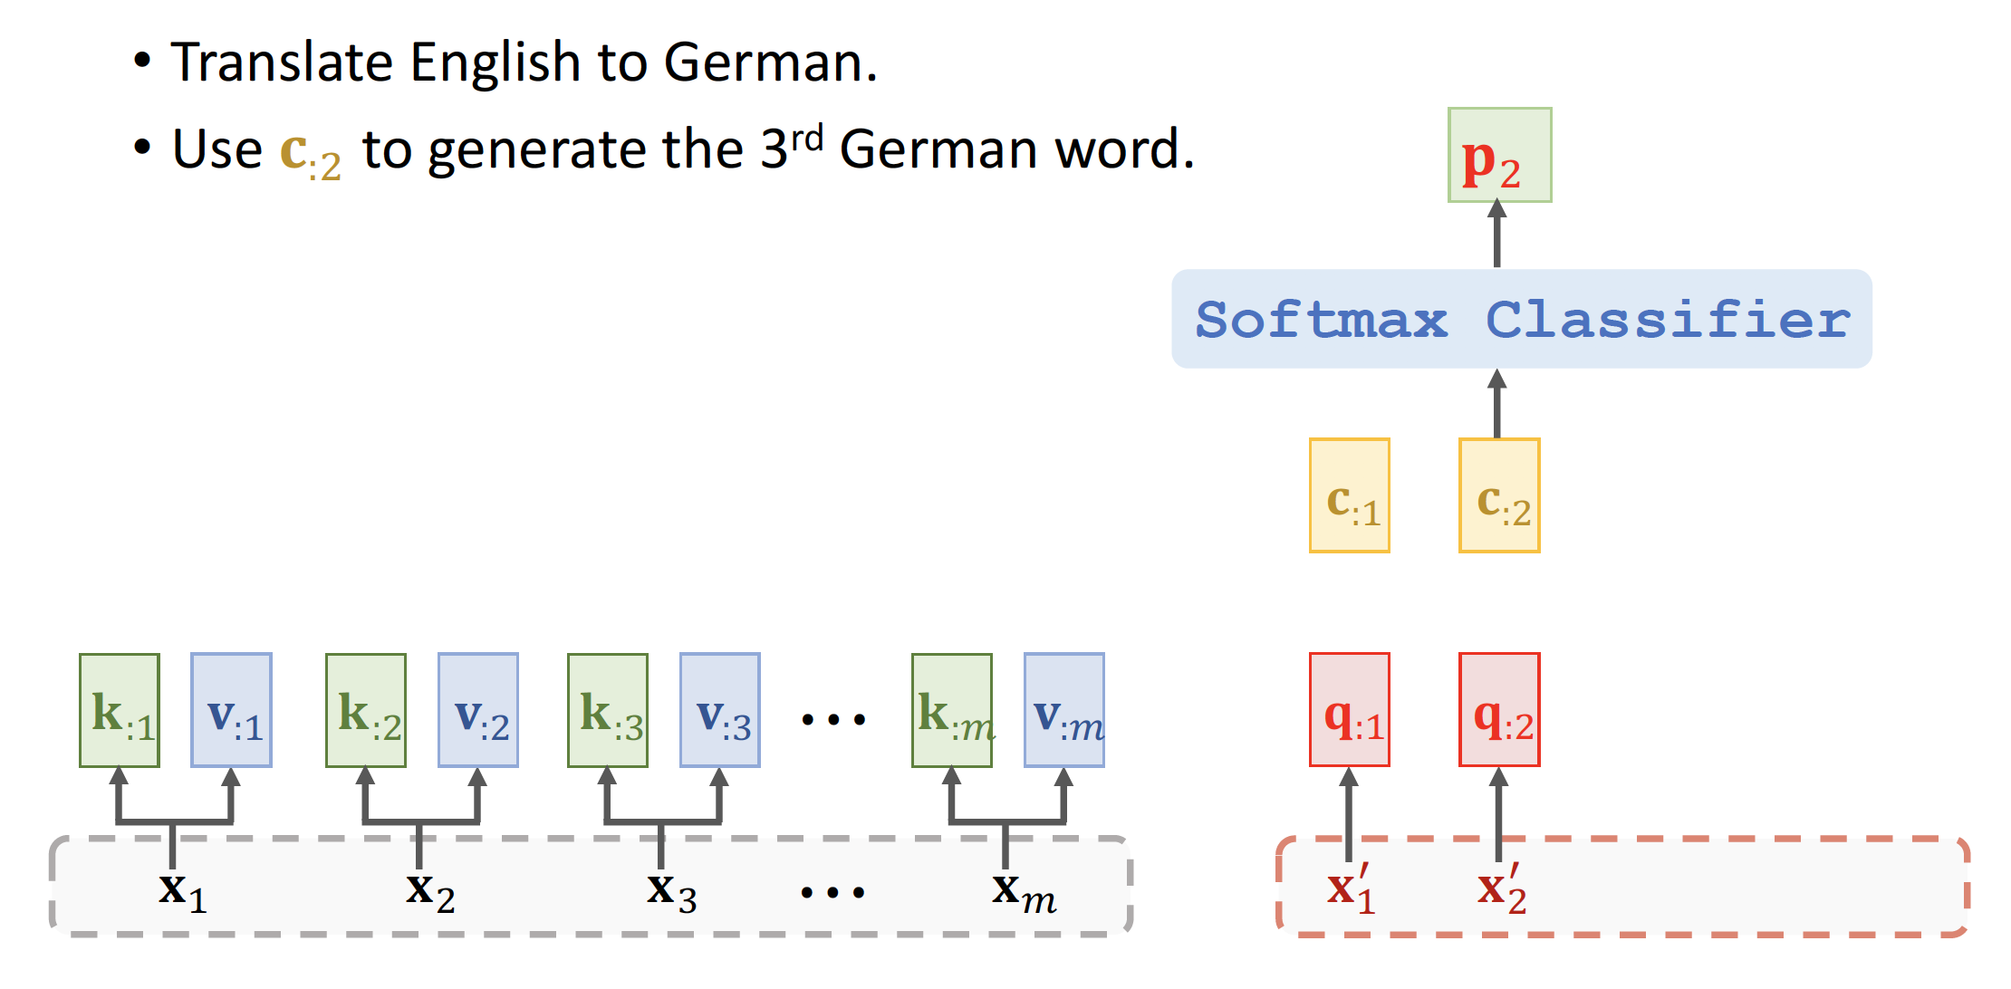
Attention Layer for Machine Translation

Slide 28
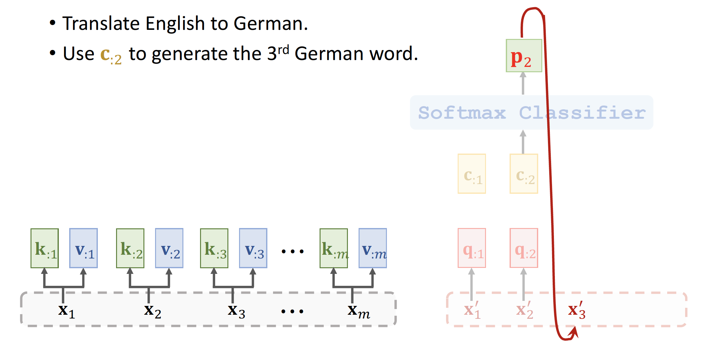
Attention Layer for Machine Translation

Slide 29
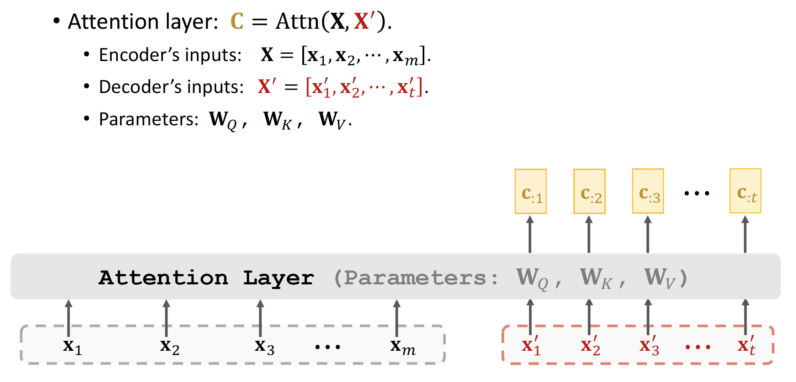
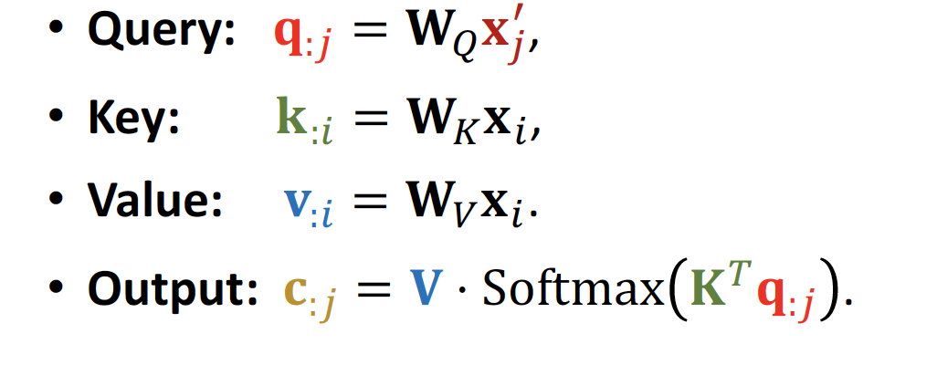
Attention Layer

Slide 30
Self-Attention without RNN

Slide 31
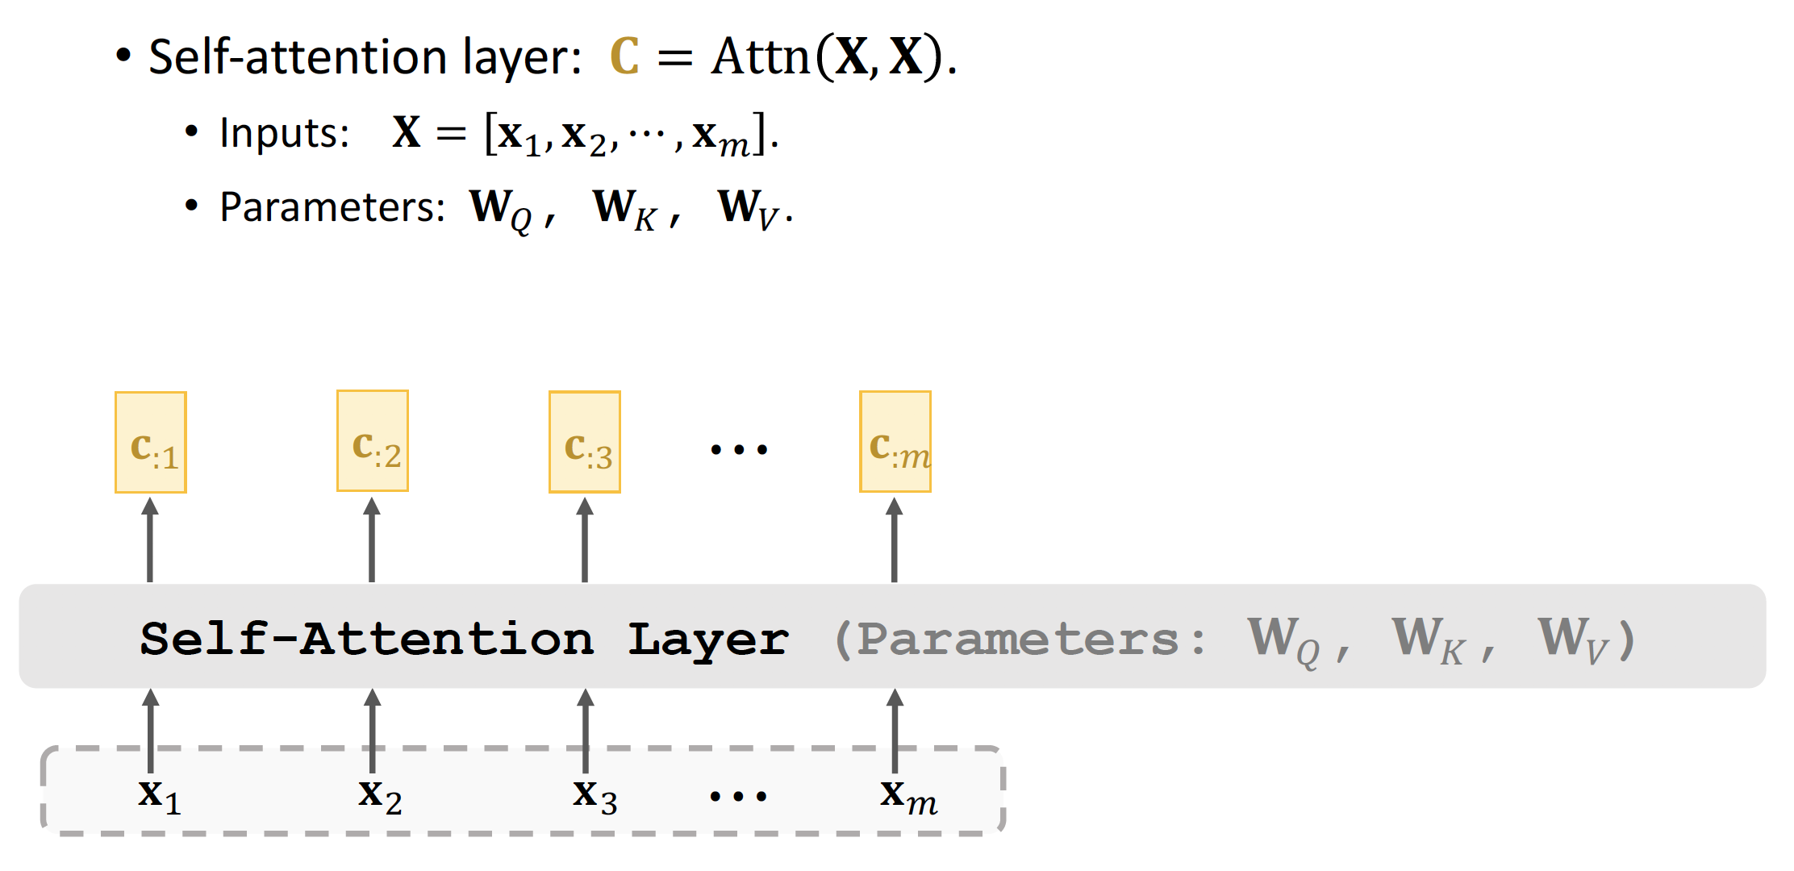
Self-Attention Layer

Slide 32
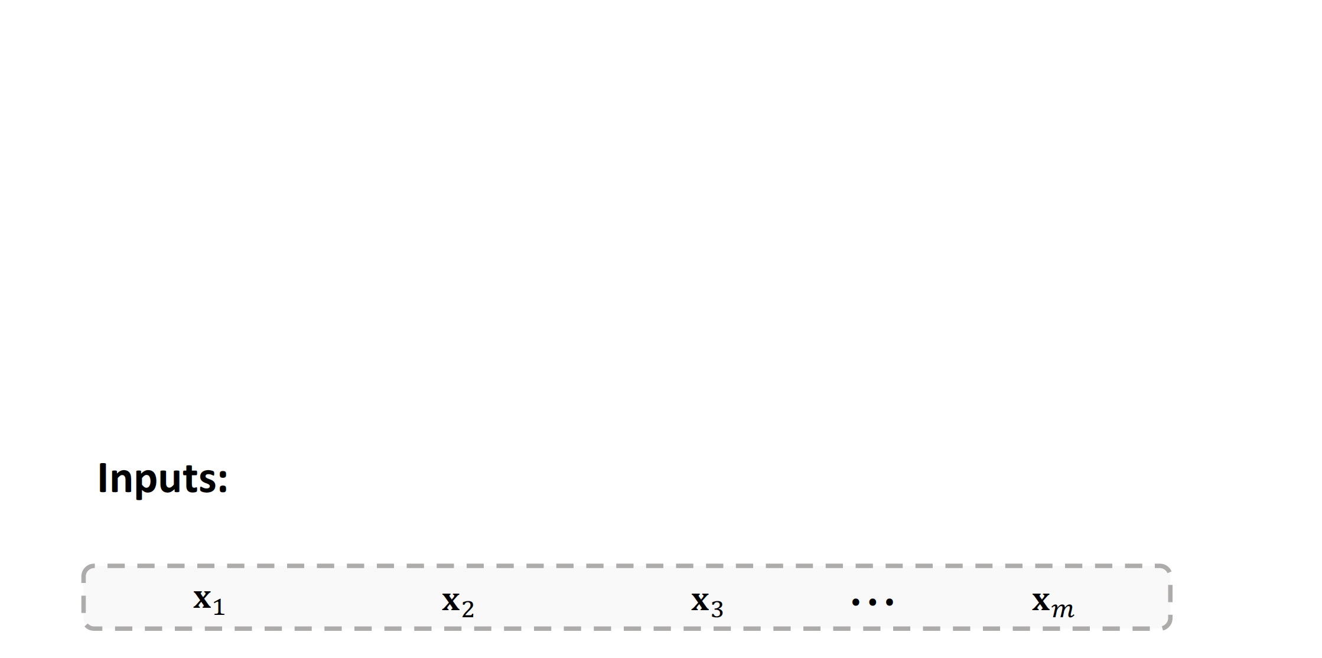
Self-Attention Layer

Slide 33
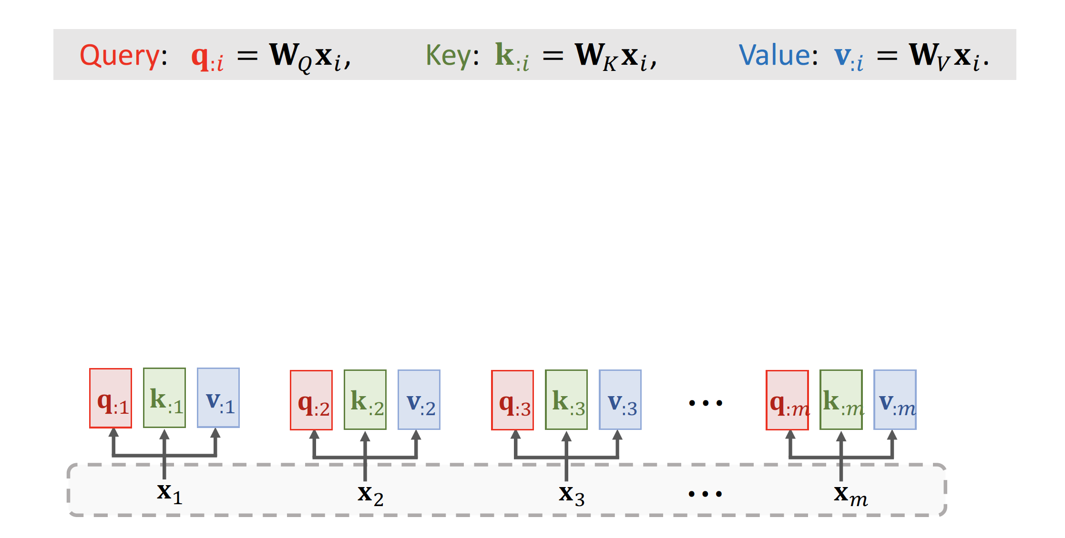
Self-Attention Layer

Slide 34
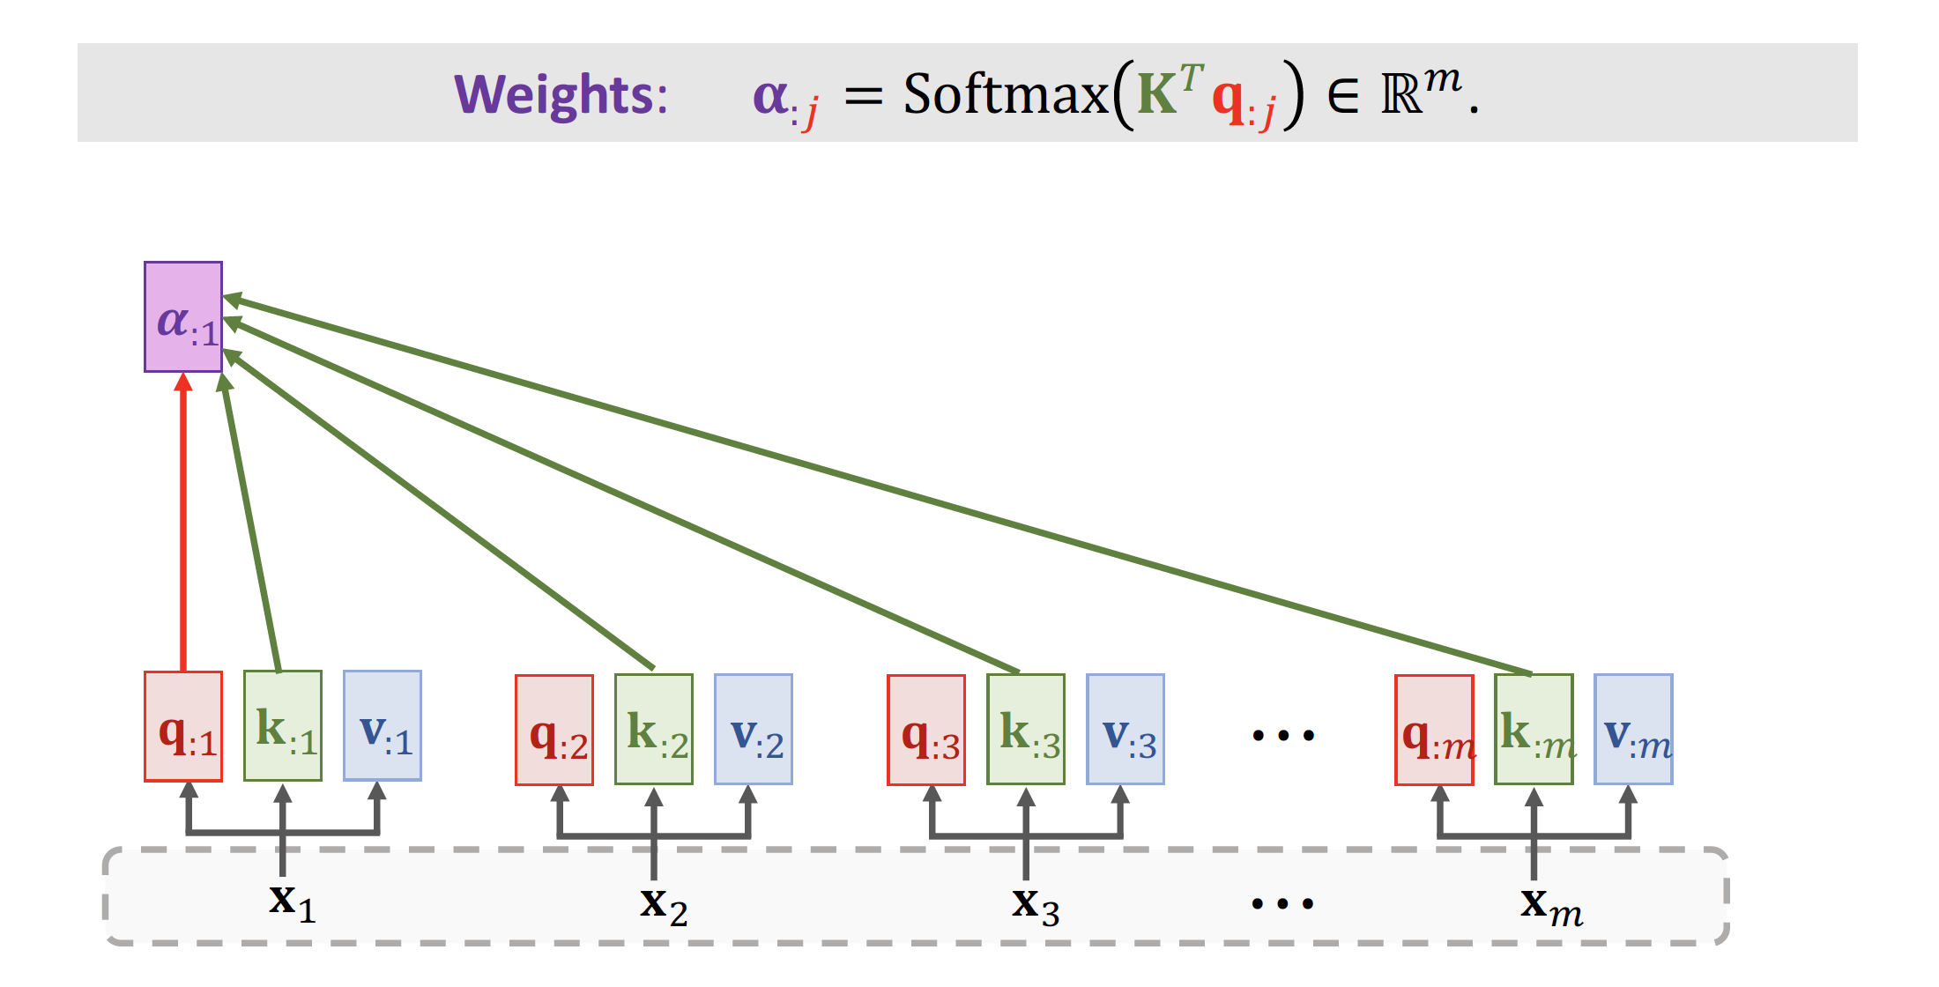
Self-Attention Layer

Slide 35
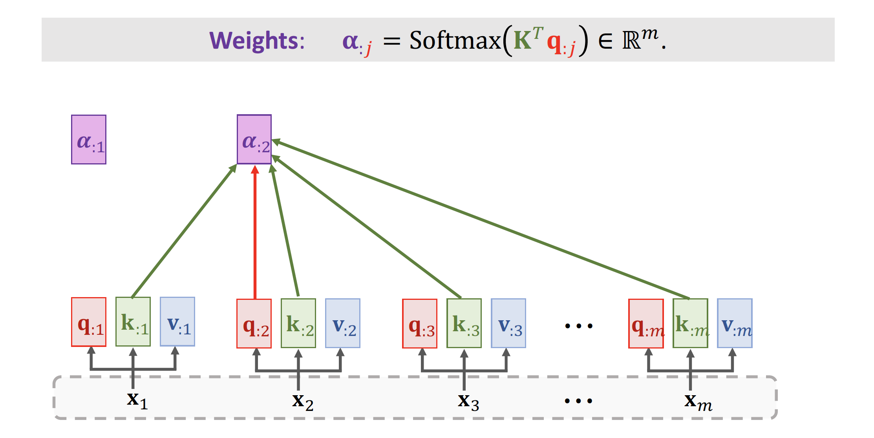
Self-Attention Layer

Slide 36
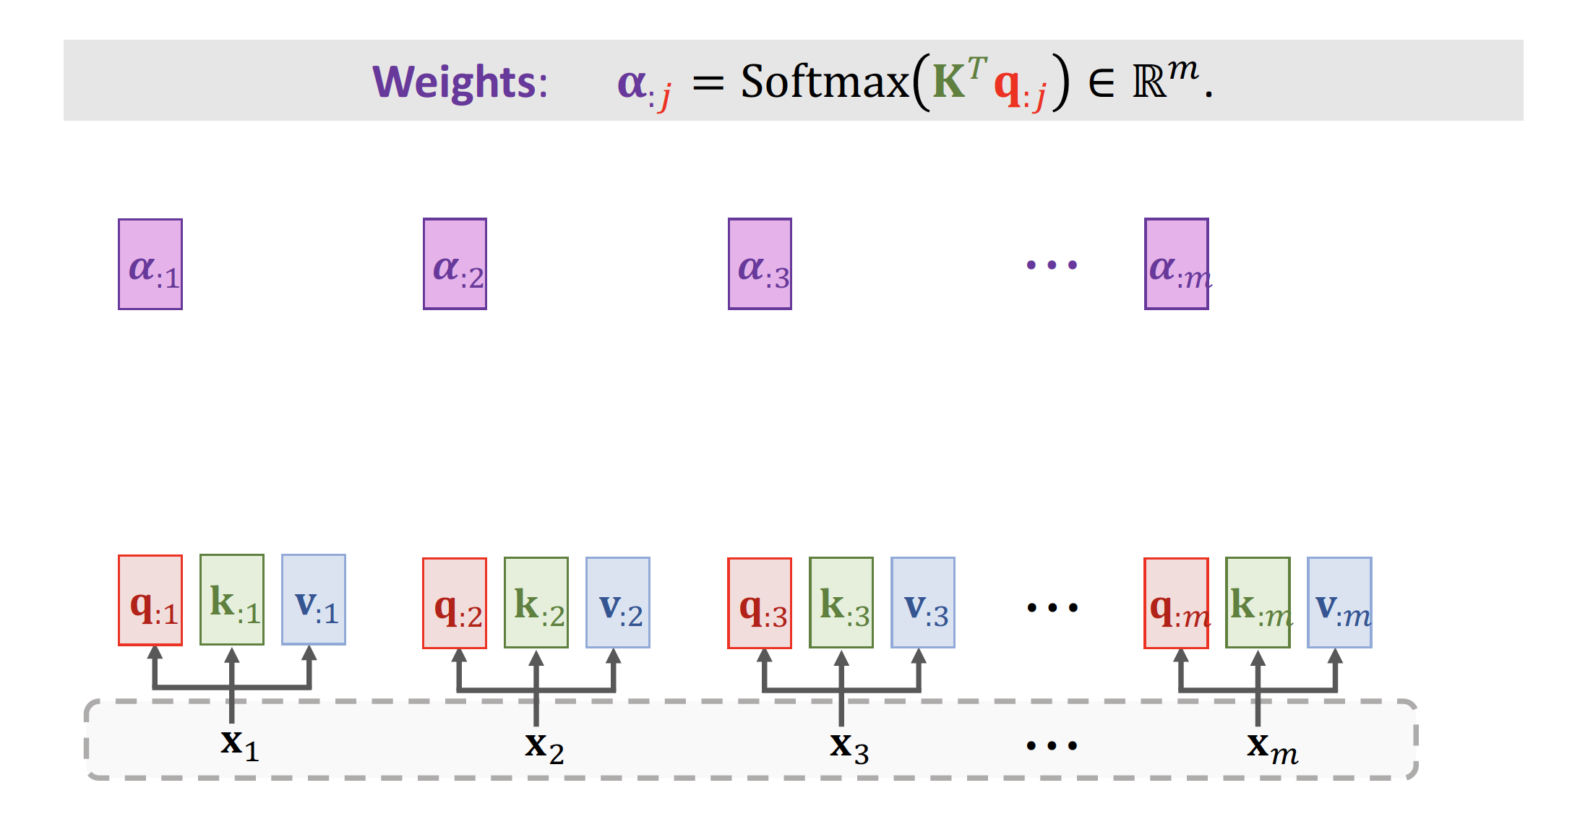
Self-Attention Layer

Slide 37
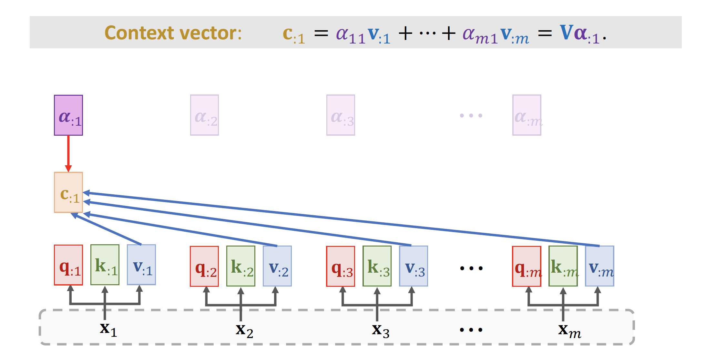
Self-Attention Layer

Slide 38
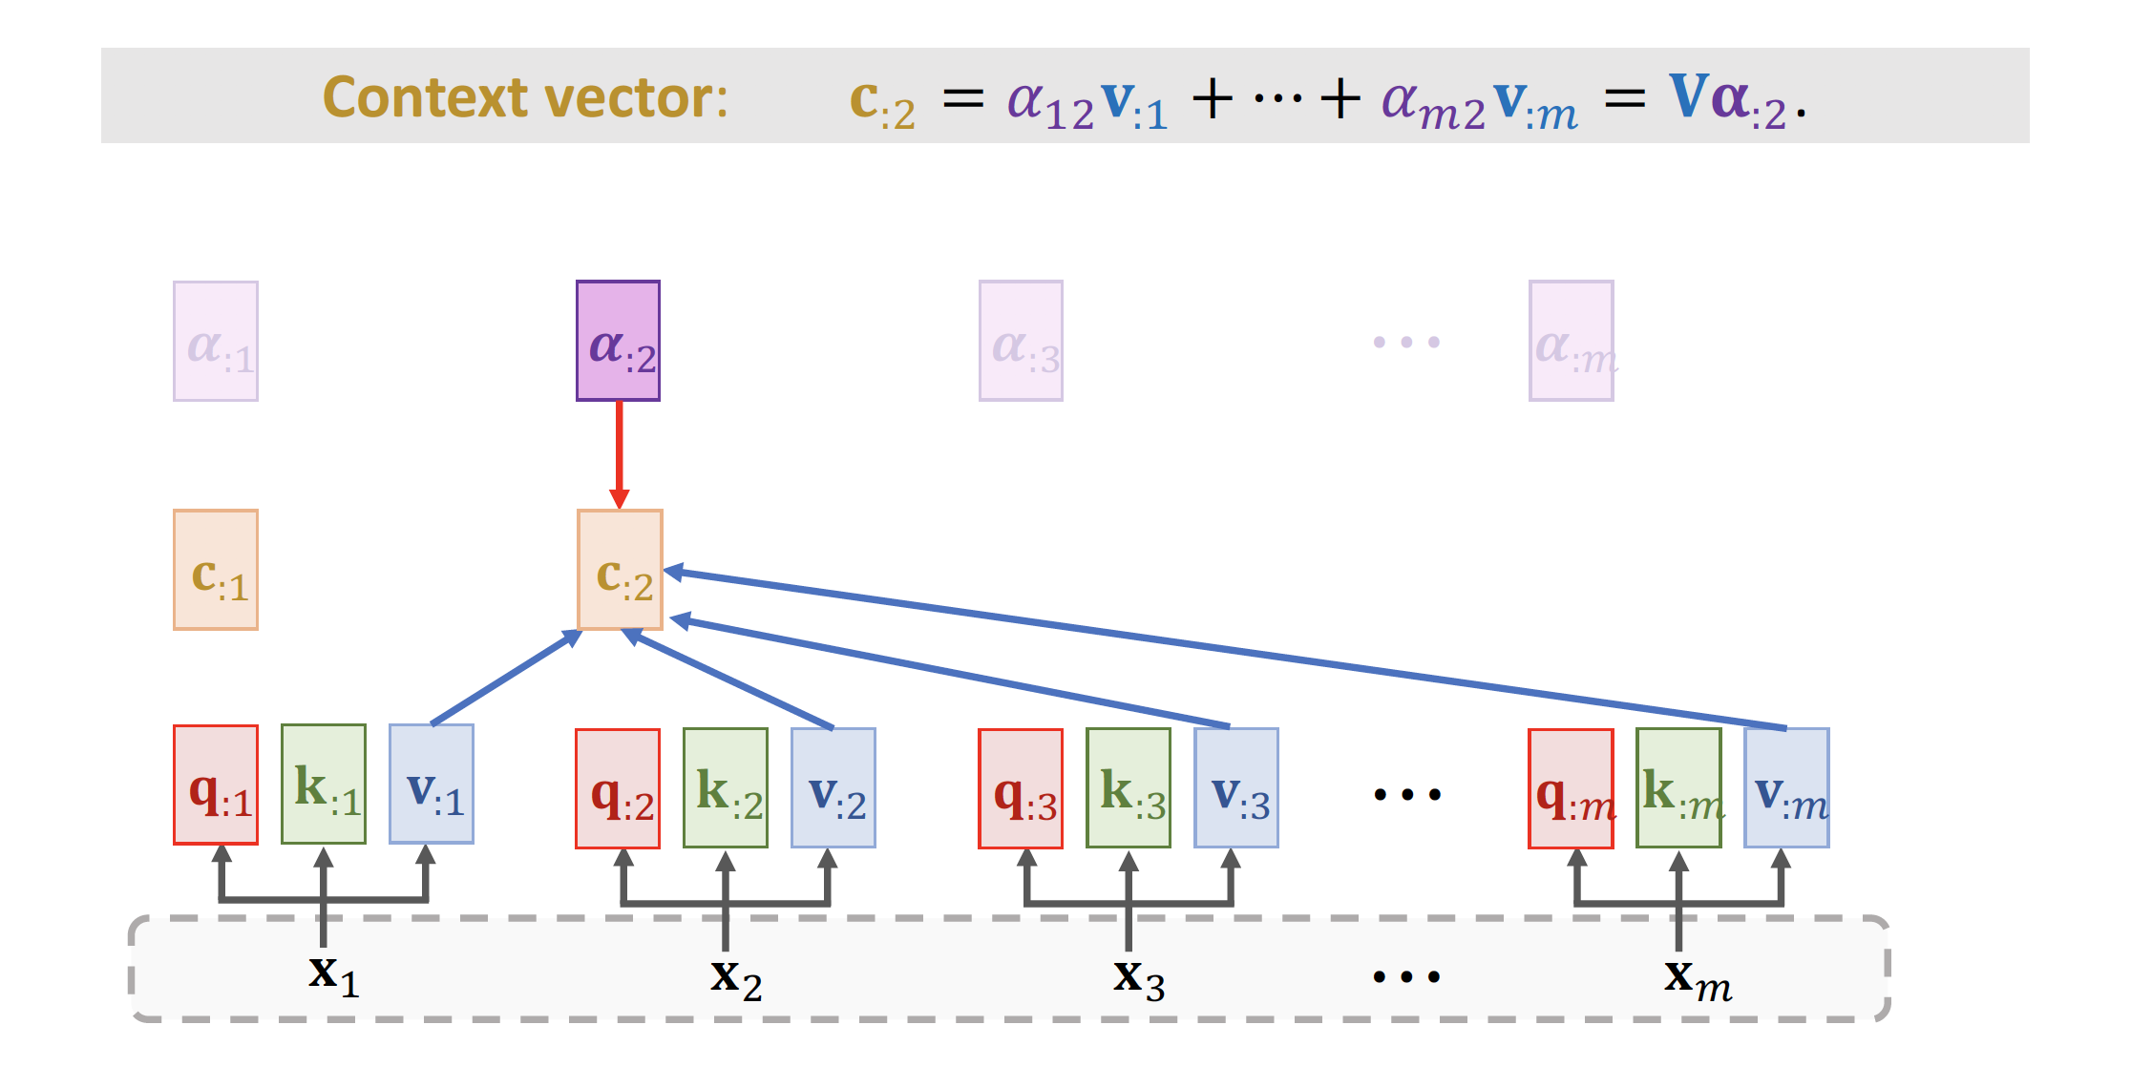
Self-Attention Layer

Slide 39
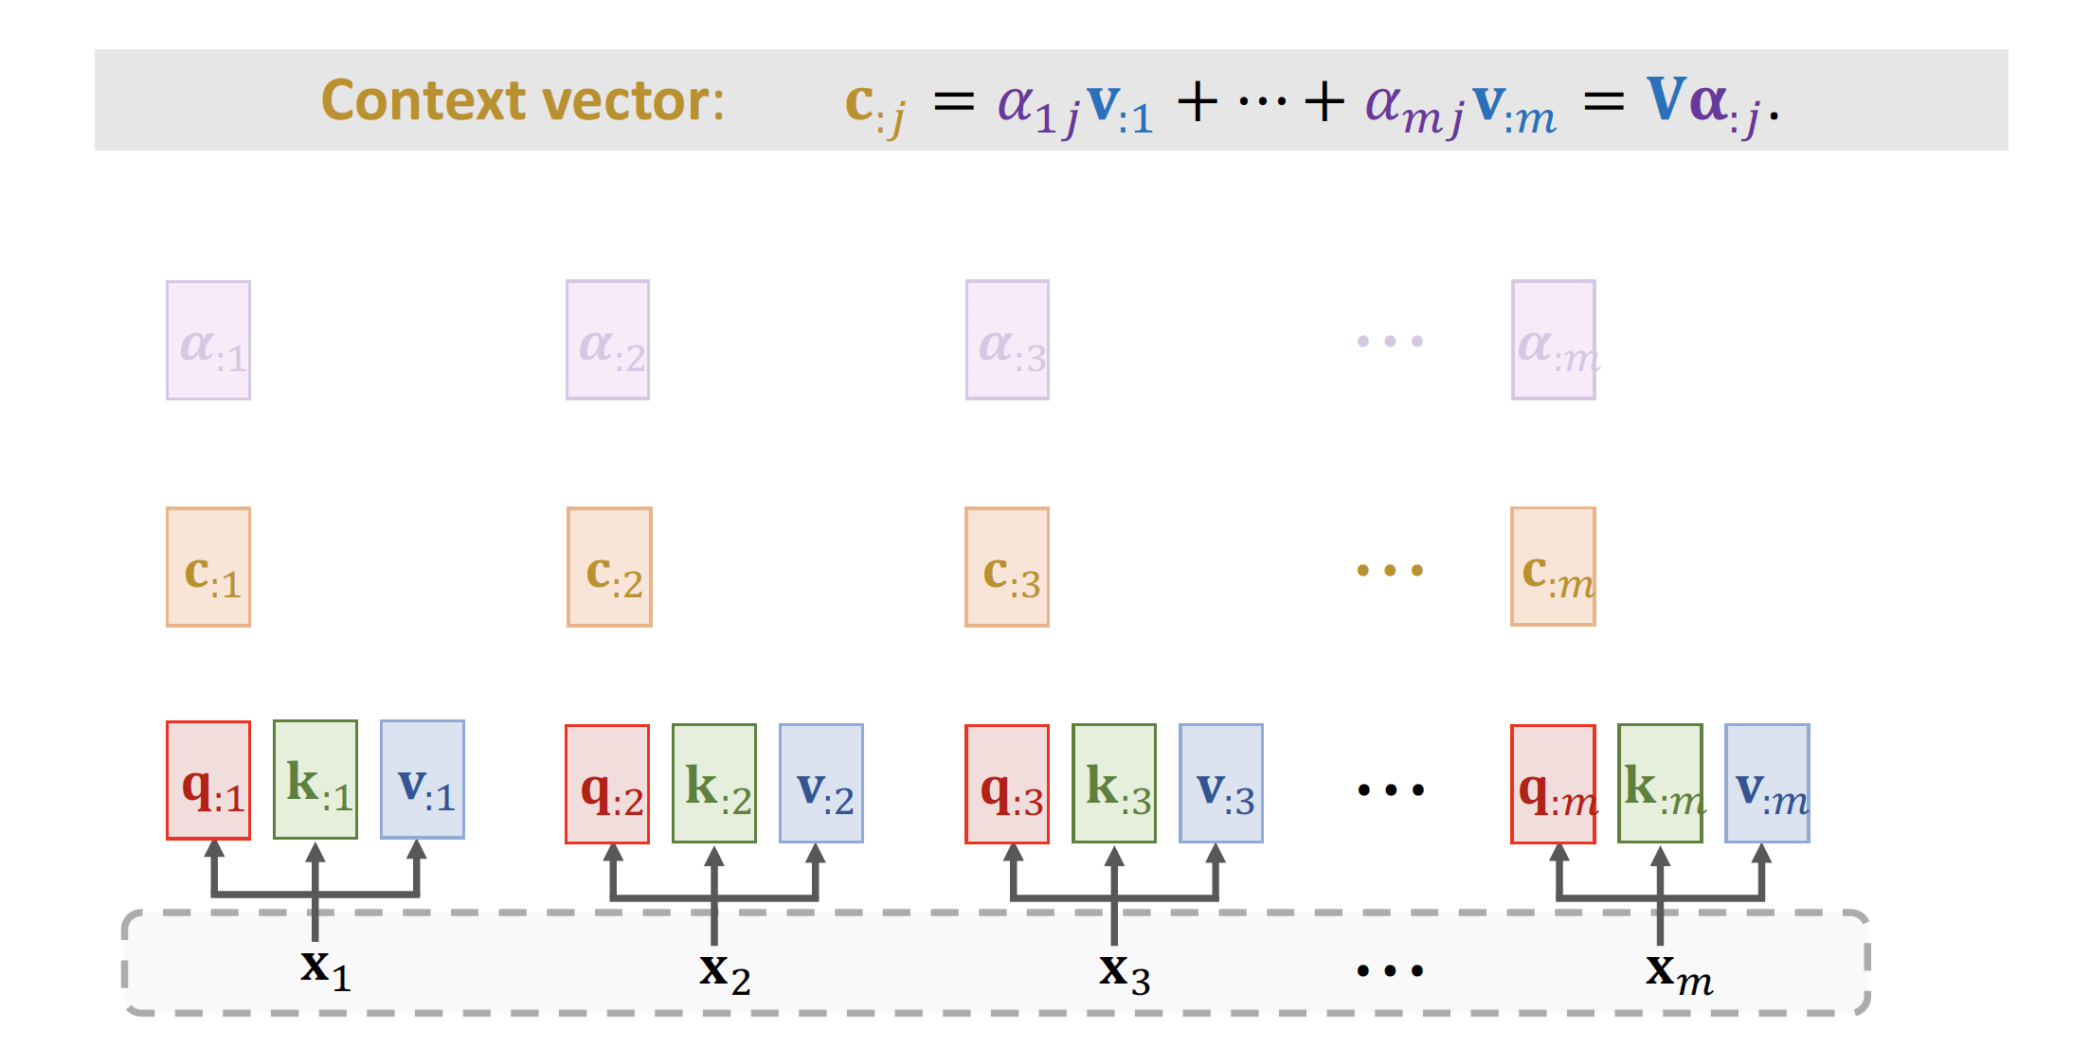
Self-Attention Layer

Slide 40
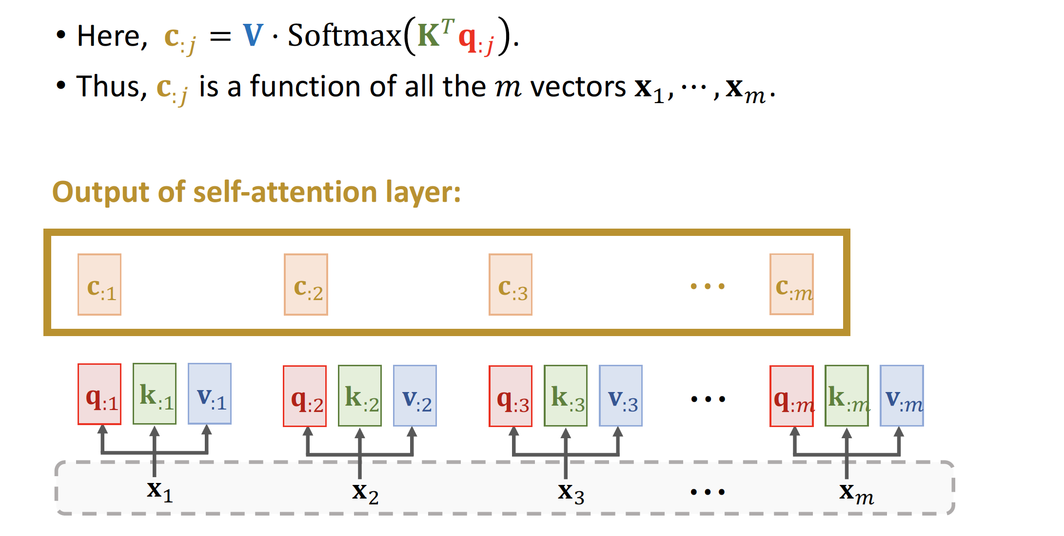
Self-Attention Layer

Slide 41
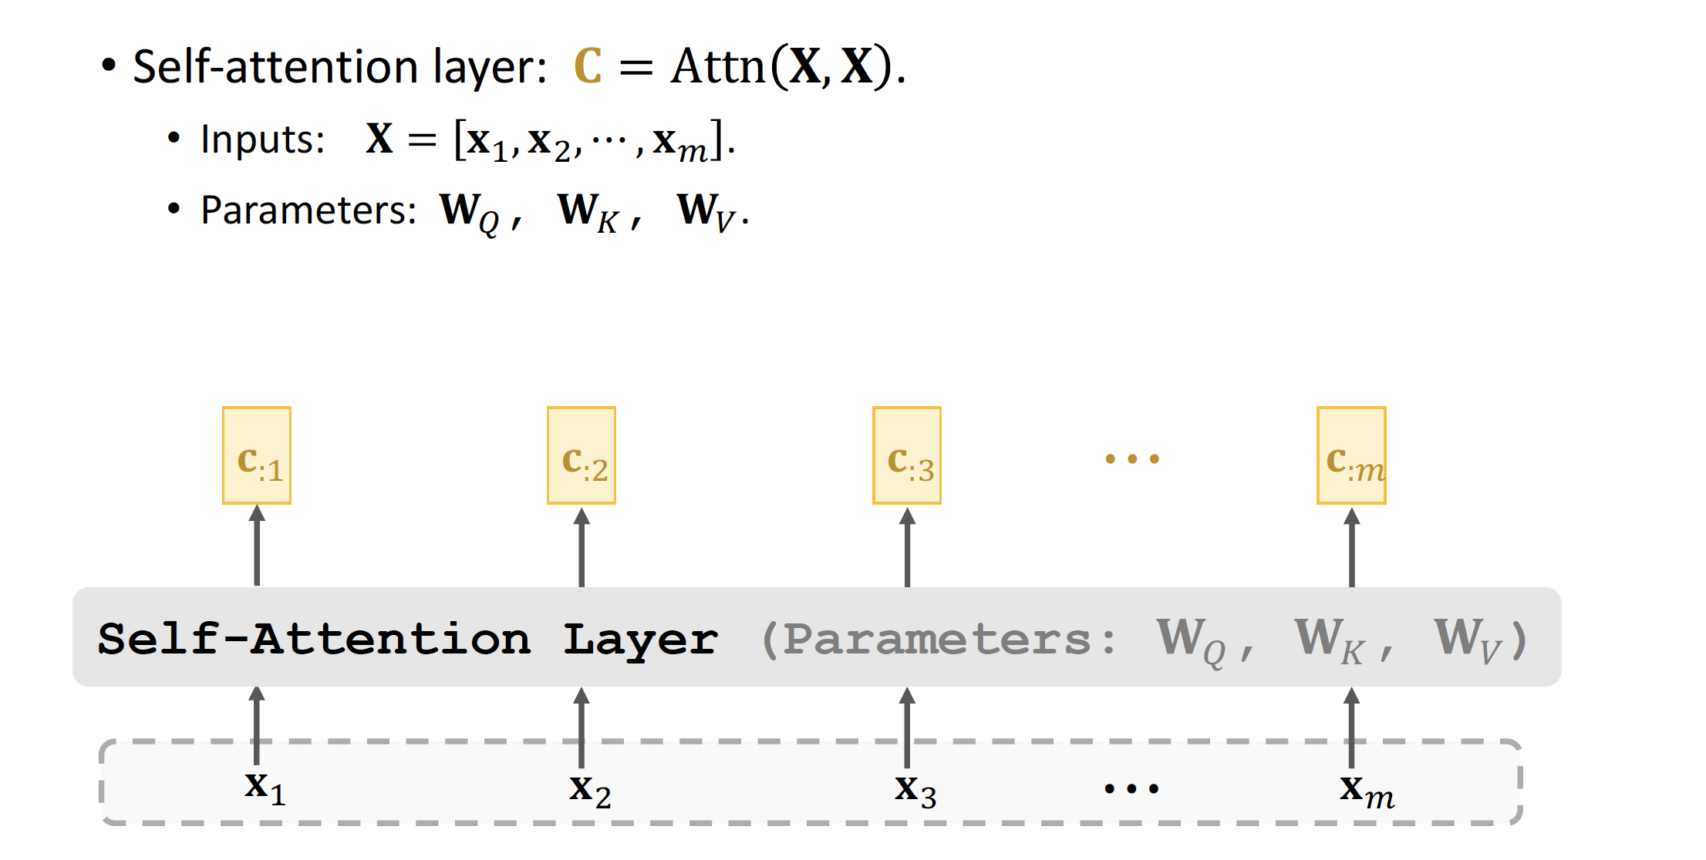
Self-Attention Layer

Slide 42
Summary
Attention was originally developed for Seq2Seq RNN models [1].
Self-attention: attention for all the RNN models (not necessarily Seq2Seq models [2].
Attention can be used without RNN [3].
We learned how to build attention layer and self-attention layer.
Reference:
Bahdanau, Cho, & Bengio. Neural machine translation by jointly learning to align and translate. In ICLR, 2015.
Cheng, Dong, & Lapata. Long Short-Term Memory-Networks for Machine Reading. In
EMNLP, 2016.
Vaswani et al. Attention Is All You Need. In NIPS, 2017.

Slide 43
Transformer Model
Transformer is Seq2Seq model; it has an encoder and a decoder.
Transformer model is not RNN.
Transformer is based on multi-head attention and multi-head self-attention.

Slide 44
From Single-Head to Multi-Head
Single-head self-attention can be combined to form a multi-head self-attention.
Single-head attention can be combined to form a multi-head attention.

Slide 45
Multi-Head (Self-)Attention

Slide 46
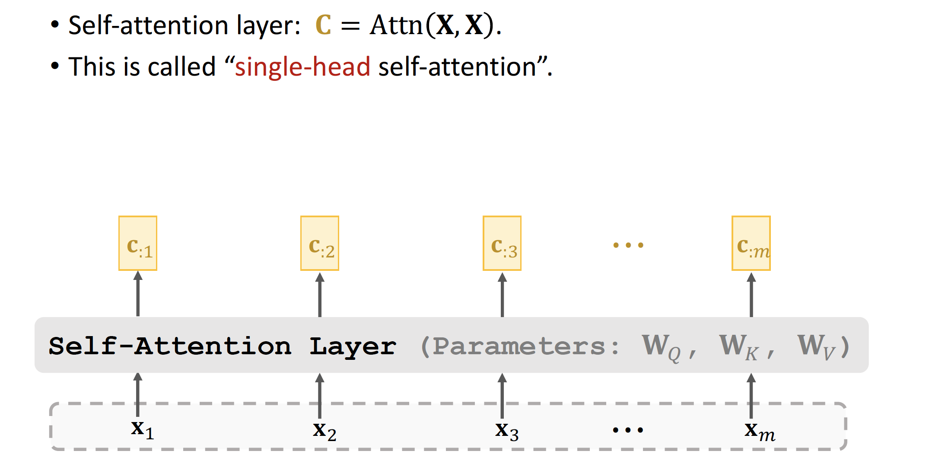
Single-Head Self-Attention

Slide 47
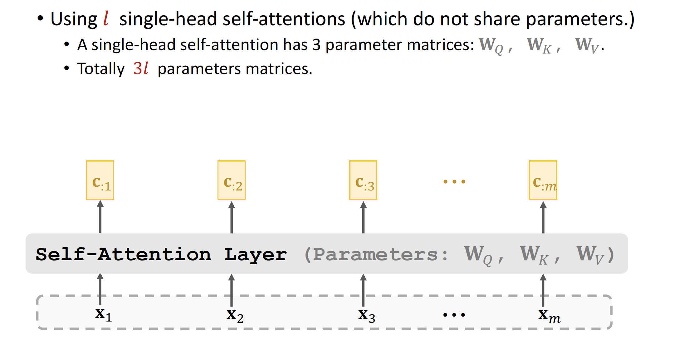
Multi-Head Self-Attention

Slide 48
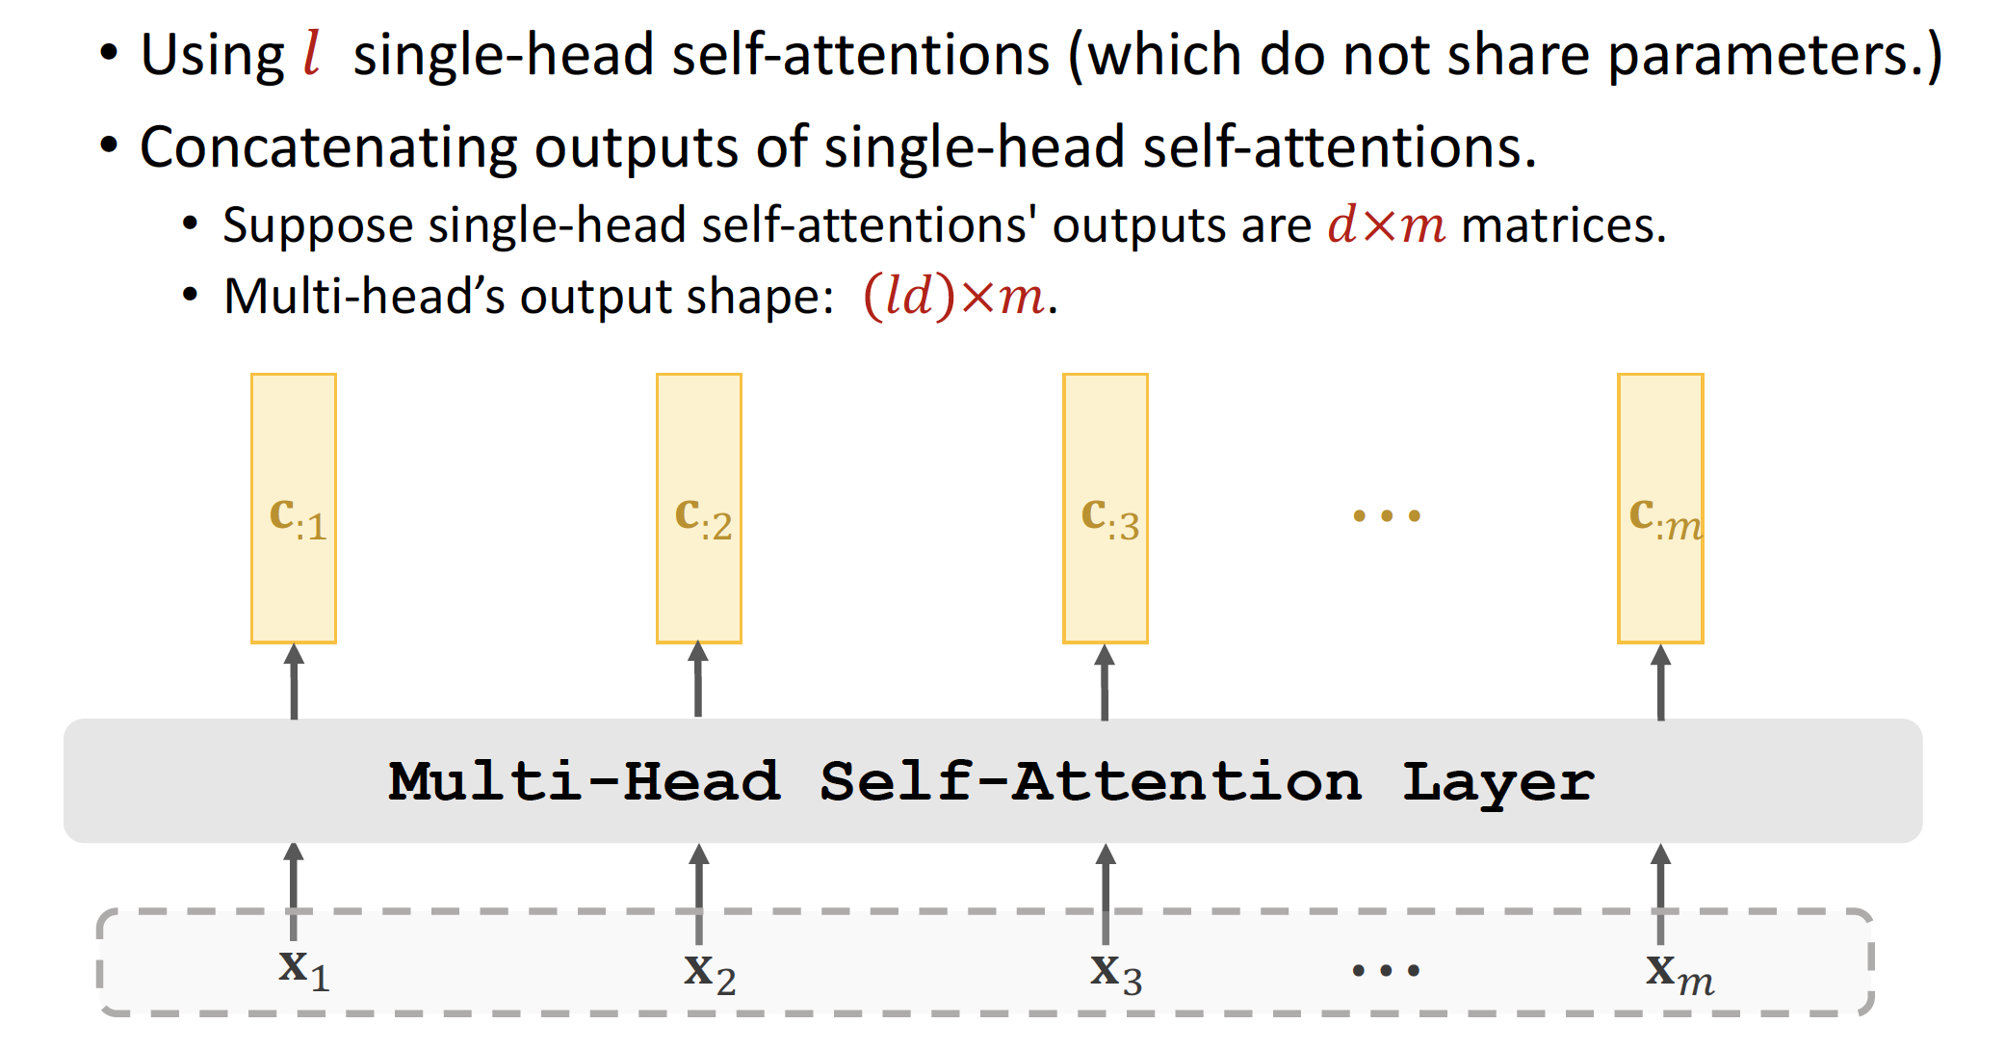
Multi-Head Self-Attention

Slide 49
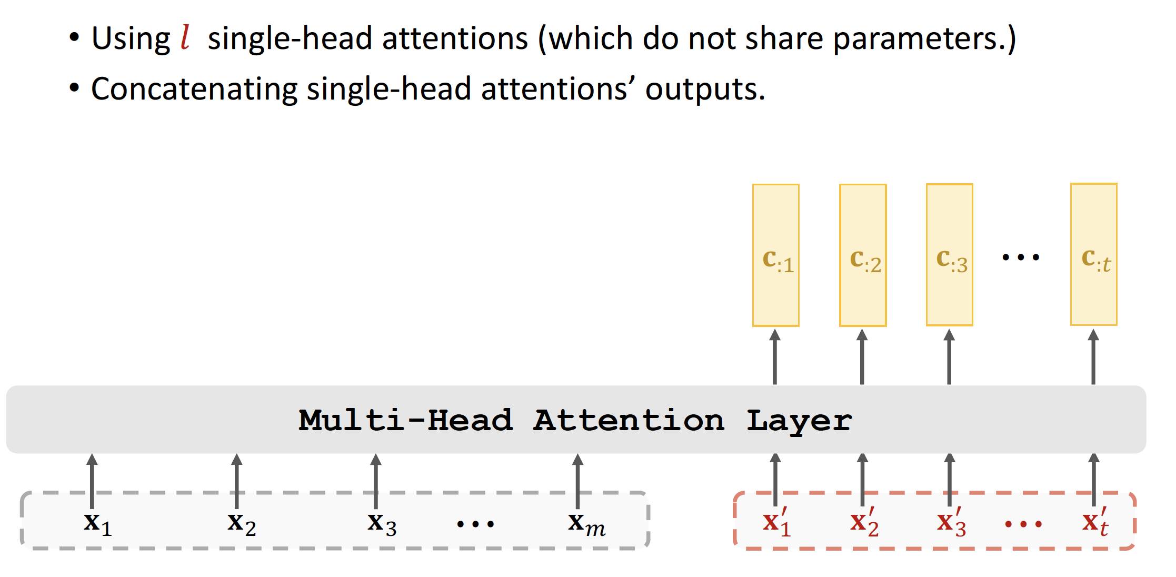
Multi-Head Attention

Slide 50
Transformer’s Encoder
Encoder is a stack of 6 blocks.
1 encoder block ≈ multi-head self-attention + dense.

Slide 51
Transformer’s Encoder
512×𝑚 matrix
Dense Layer Self-Attention Layer
512×𝑚 matrix
One Block of Encoder

Slide 52
Transformer’s Encoder
512×𝑚 matrix
Dense Layer Self-Attention Layer
512×𝑚 matrix
One Block of Encoder
512×𝑚 matrix
Block 1
_{𝐗 ∈ ℝ512xm}

Slide 53
Transformer’s Encoder
512×𝑚 matrix
Dense Layer Self-Attention Layer
512×𝑚 matrix
One Block of Encoder
512×𝑚 matrix
Block 2
Block 1
_{𝐗 ∈ ℝ512xm}

Slide 54
Transformer’s Encoder
512×𝑚 matrix
Block 6
⋮
Block 2
Block 1
512×𝑚 matrix
Dense Layer Self-Attention Layer
512×𝑚 matrix
One Block of Encoder
_{𝐗 ∈ ℝ512xm}

Slide 55
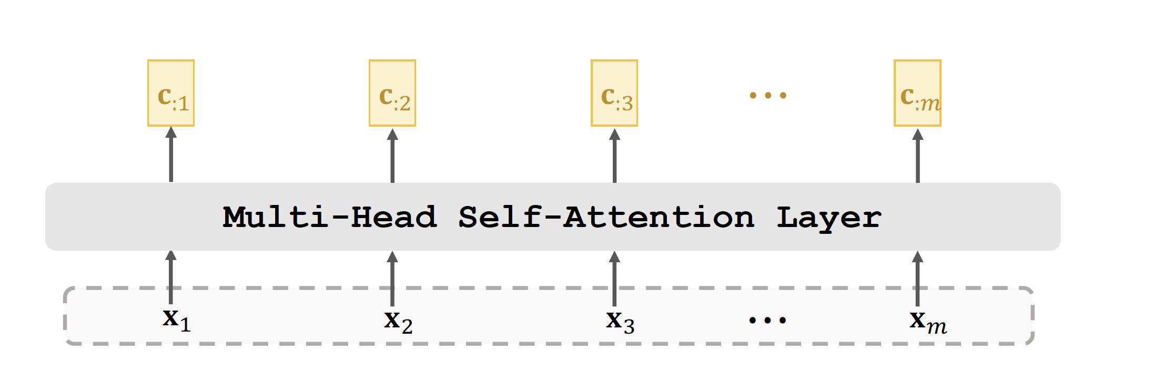
Self-Attention Layer

Slide 56
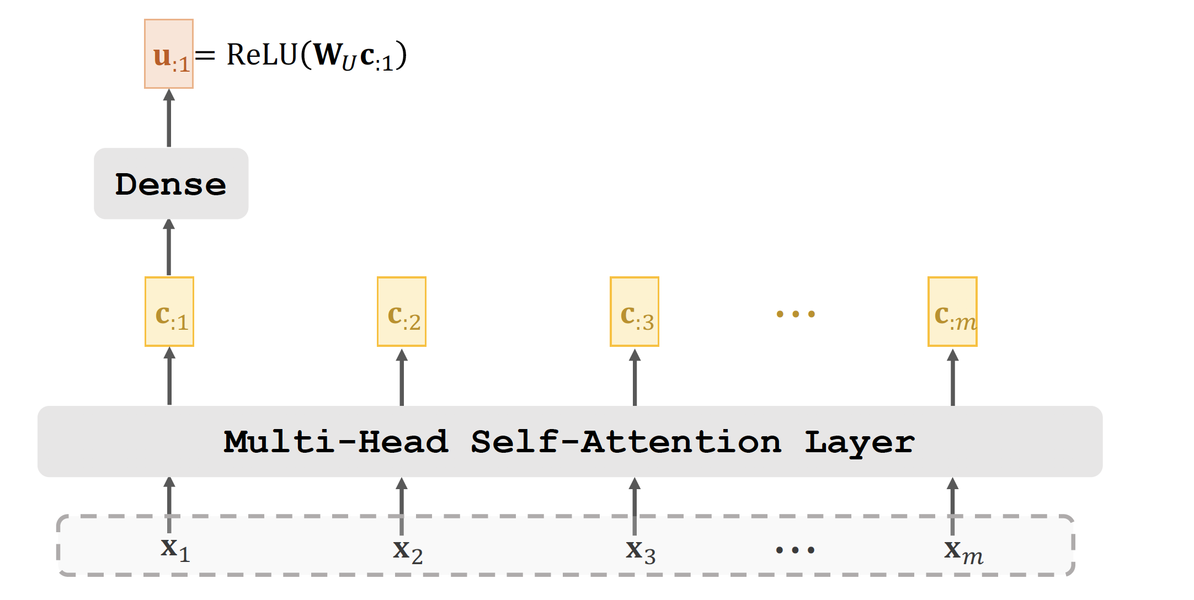
Self-Attention Layer + Dense Layer

Slide 57
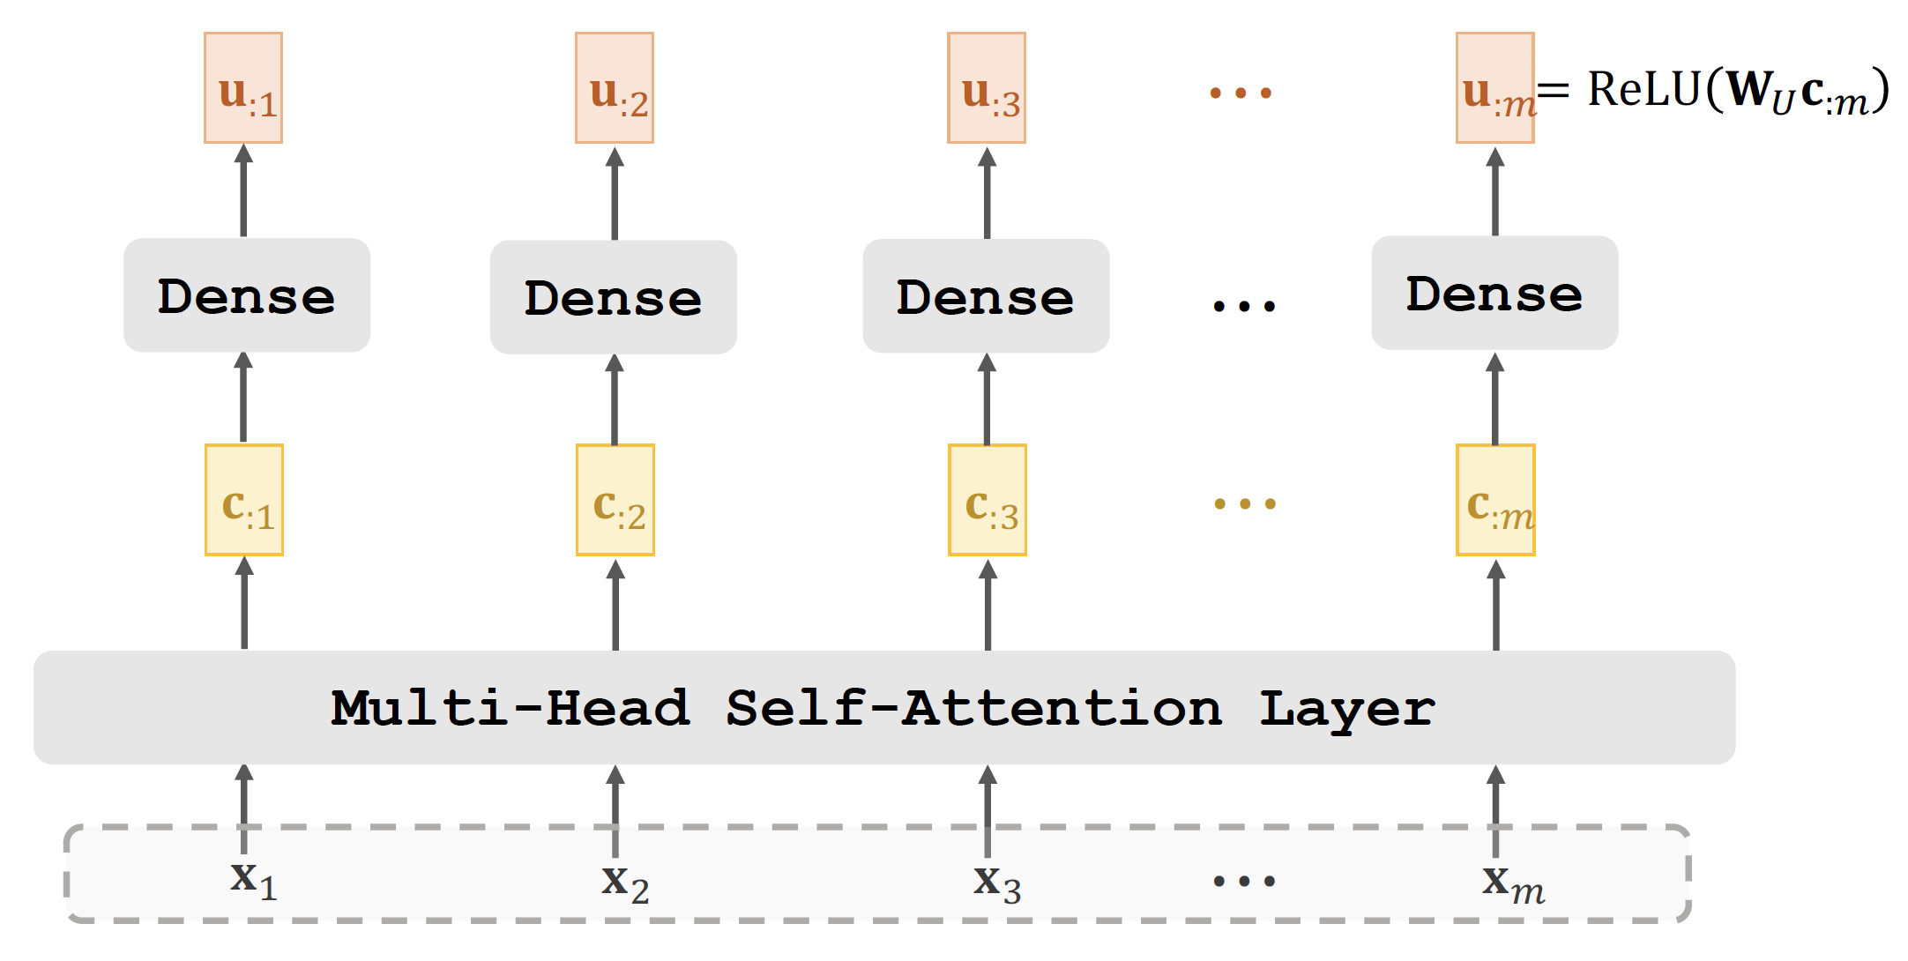
Self-Attention Layer + Dense Layer

Slide 58
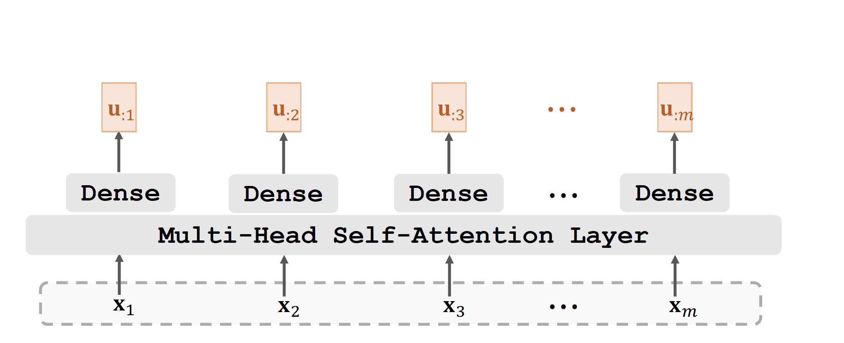
Stacked Self-Attention Layers

Slide 59
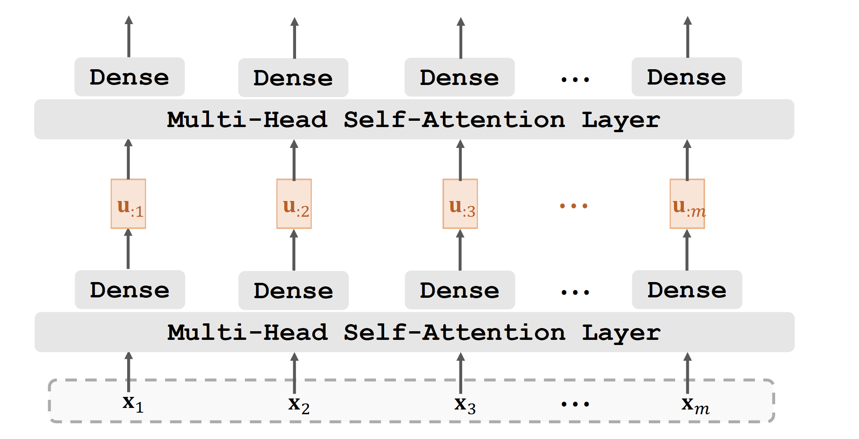
Stacked Self-Attention Layers

Slide 60
Transformer’s Decoder
Decoder network is a stack of 6 blocks.
1 decoder block ≈ multi-head self-attention + multi-head attention
+ dense.

Slide 61
Transformer’s Decoder : One Block
512×𝑡 matrix
Dense Layer Attention Layer
Self-Attention Layer
512×𝑡 matrix
One Block
512×𝑚 matrix
512×𝑡 matrix
512×𝑚 matrix
512×𝑡 matrix

Slide 62
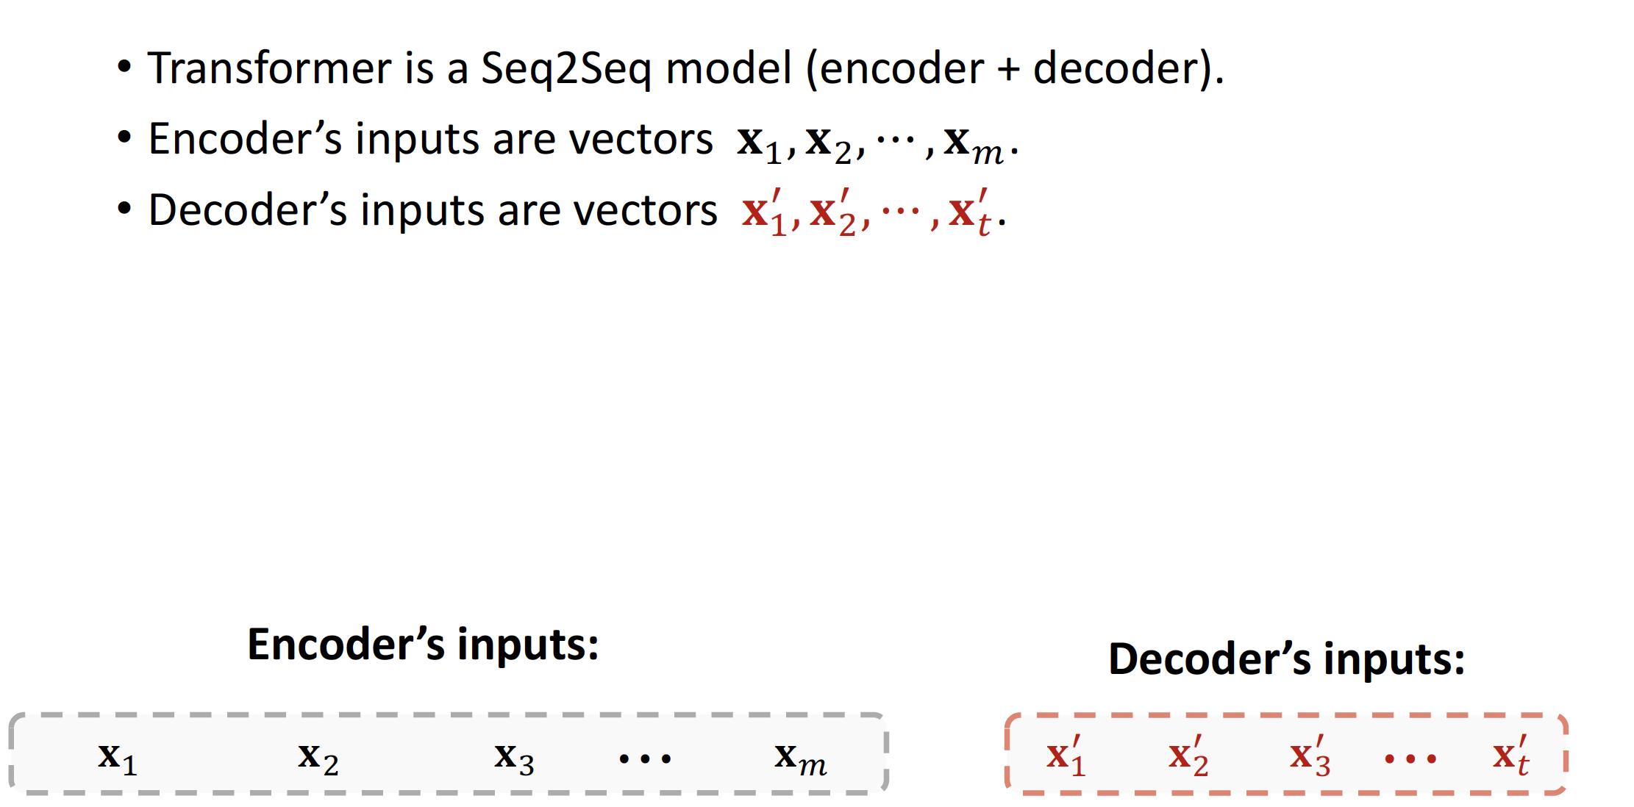
Stacked Attentions

Slide 63
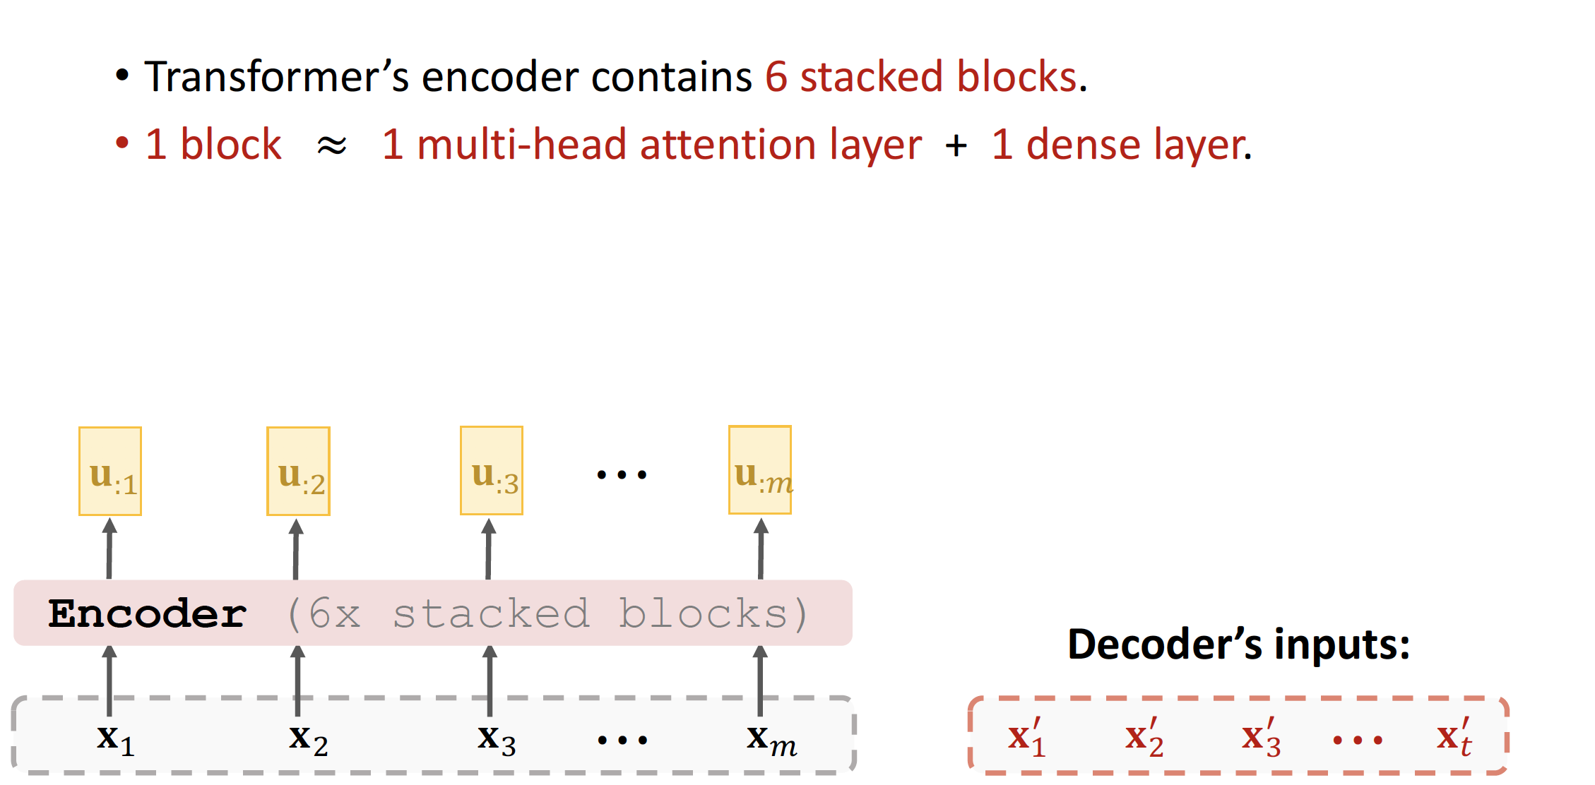
Stacked Attentions

Slide 64
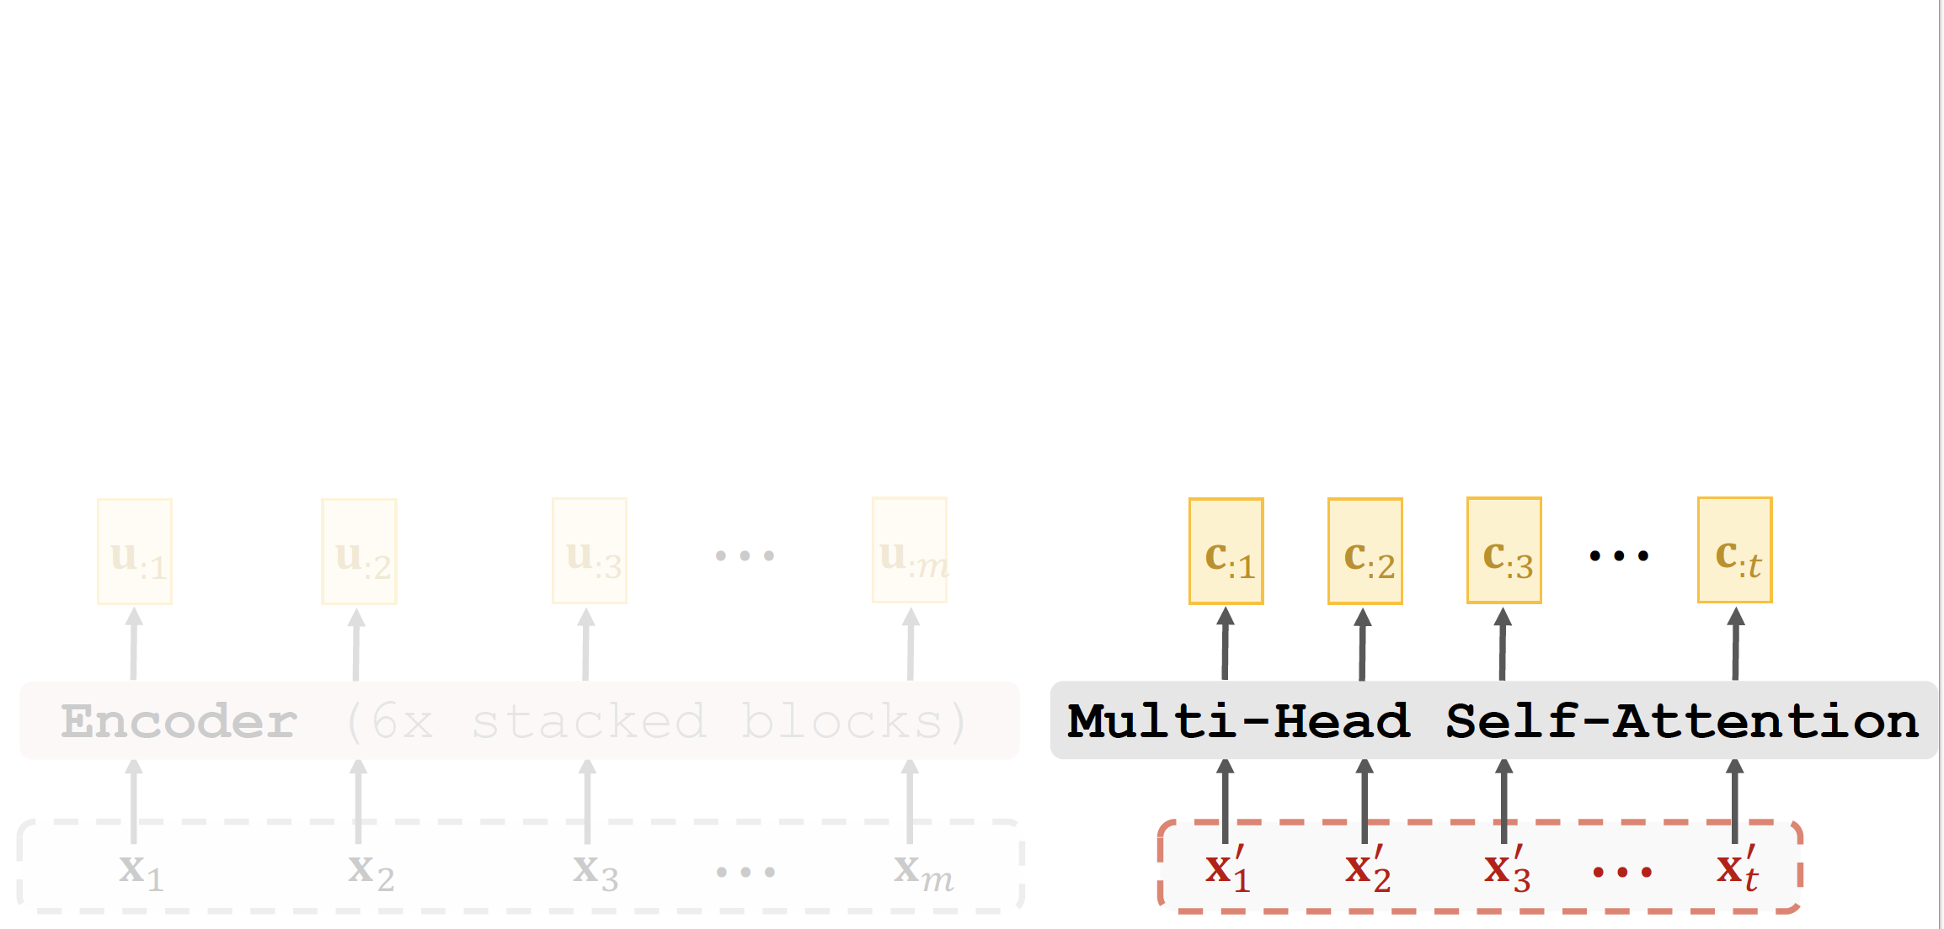
Stacked Attentions

Slide 65
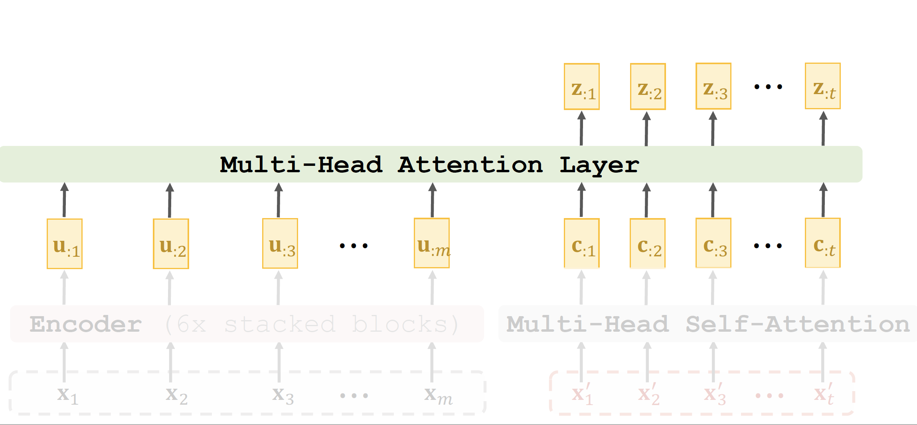
Stacked Attentions

Slide 66
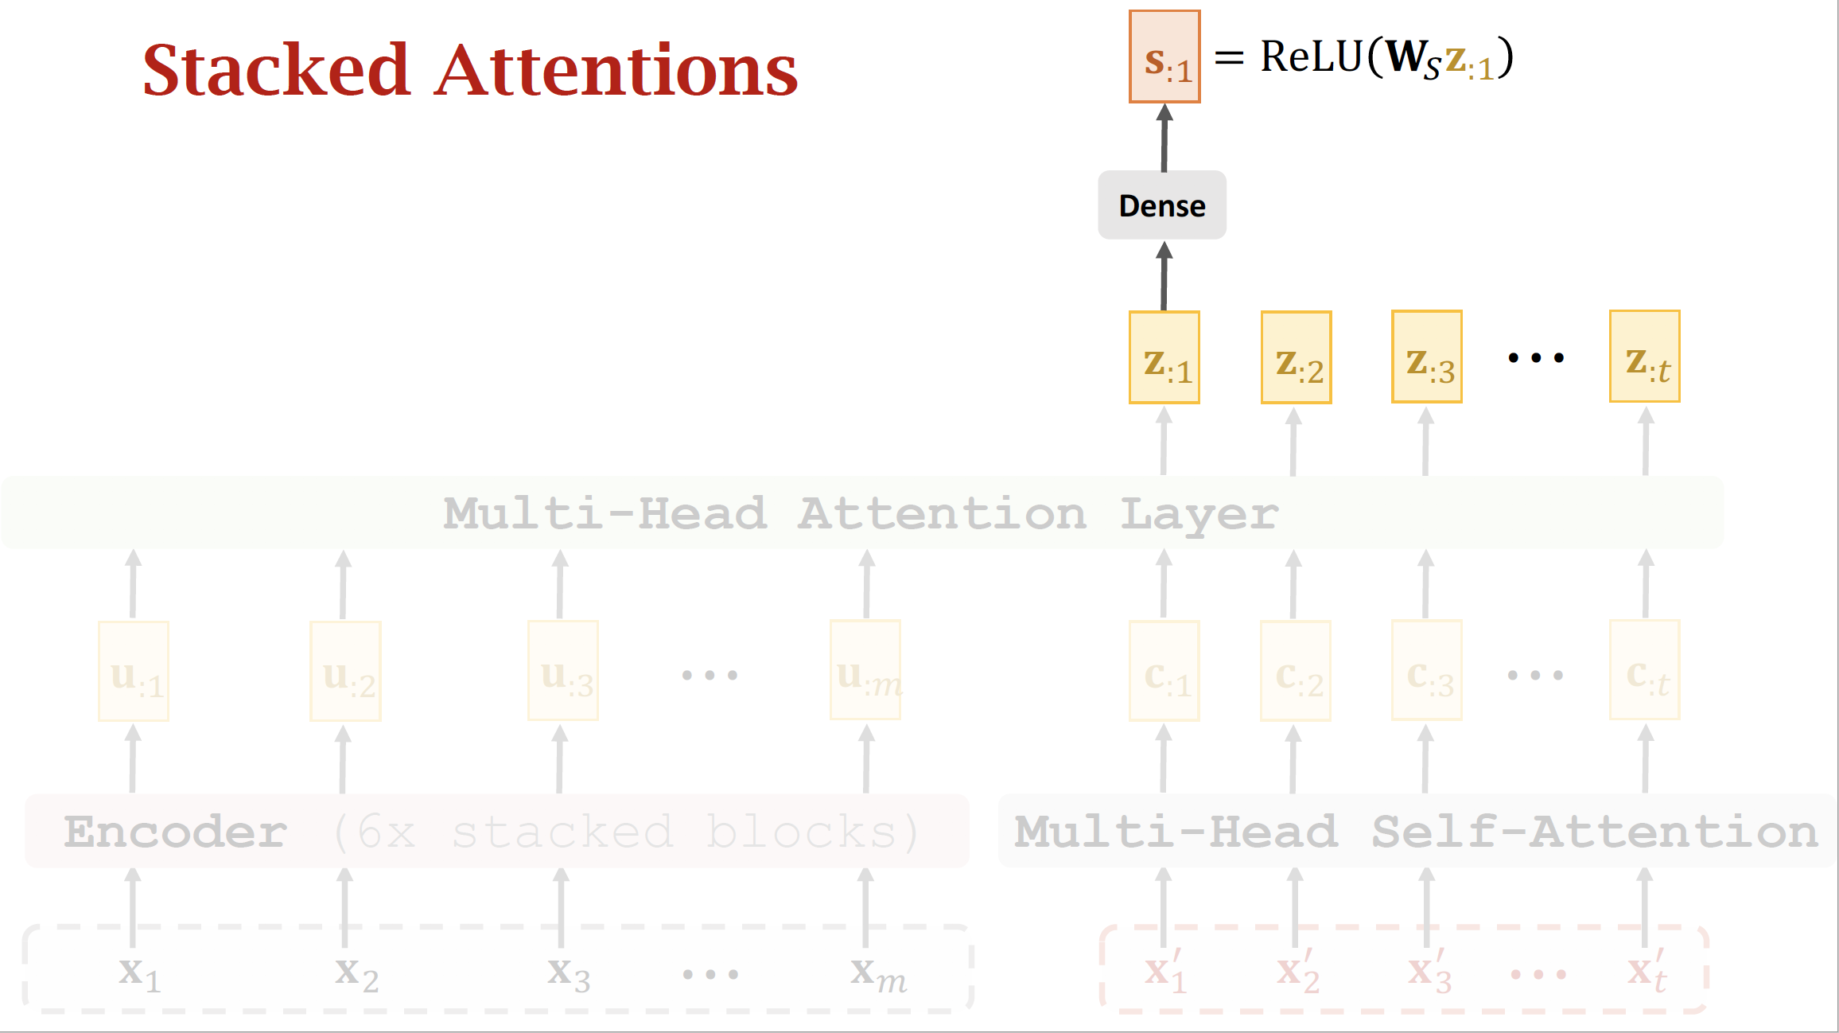

Slide 67


Slide 68


Slide 69
Put Everything Together

Slide 70

Transformer

Slide 71

Transformer

Slide 72

Transformer

Slide 73

Transformer

Slide 74

Comparison with RNN Seq2Seq Model

Slide 75
Any Question ?

